Slide 1
Why are state cancer registries critically important in the fight against cancer?

Slide 2
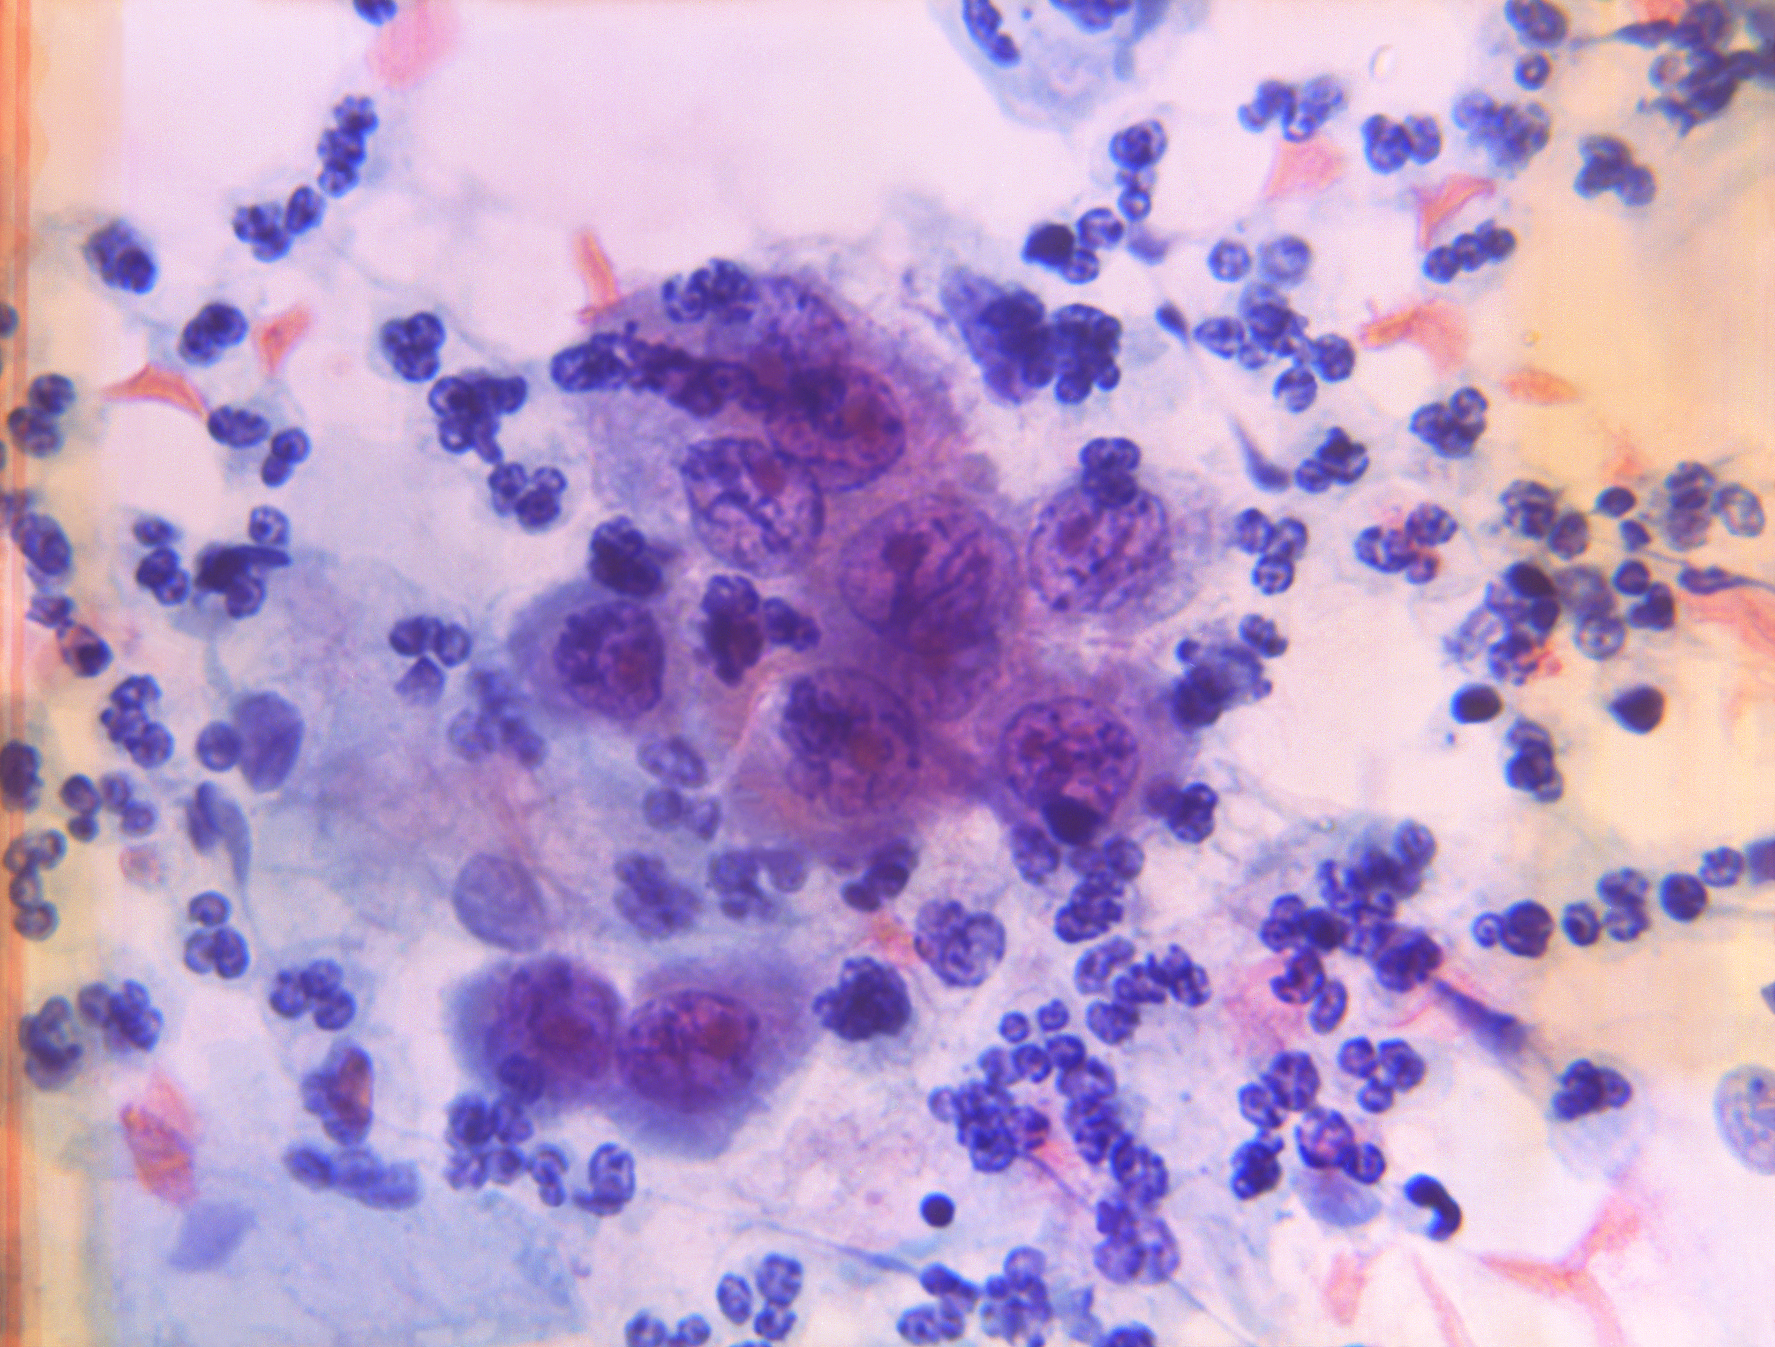
1. Registries tell you how important cancer is
1 in 3 Americans will get cancer
Every day, 5,600 Americans are newly diagnosed with cancer
Every minute, 1 American dies from cancer
https://www.cancer.org/research/cancer-facts-statistics/all-cancer-facts-figures/2025-cancer-facts-figures.html

Slide 3

2. Registries are a cornerstone of cancer research
PubMed research publications including “cancer registry/ registries”, “SEER”, or “cancer surveillance” 42,756 research papers
Even more studies & clinical guidelines cite cancer registry data, covering:
  Trends in incidence and mortality
  Cancer in children, adolescents, young adults
  Early onset cancer (<50)
  How to prevent cancer
  How best to screen for cancer
  What are the causes of cancer?
  Who is at greater risk of cancer?
  Investigating “cancer clusters”
  Is treatment effective?
  Is treatment cost effective?
  Developing new treatments
  Developing standard treatment guidelines
  How long do people live after diagnosis?
  Factors predicting good or bad outcomes
  Who is at risk of a second cancer?
  Whose family is at greater risk of cancer?

Slide 4
2. Registries are a cornerstone of cancer research
The most cited publications on aging & cancer are registry-based
(Top 10 from Web of Science through 2022)
Rank | Article title | Times cited | Published | Citations per year
1 | Cancer statistics, 2010 | 39,141 | 2010 | 3262
2 | Cancer statistics, 2014 | 20,730 | 2014 | 2591
3 | Cancer statistics, 2016 | 16,789 | 2016 | 2798
4 | Cancer statistics in China, 2015 | 12,298 | 2016 | 2050
5 | Cancer statistics, 2008 | 9642 | 2008 | 689
6 | Cancer statistics, 2009 | 9047 | 2009 | 696
7 | Cancer statistics, 2018 | 6774 | 2018 | 1693
8 | Cancer statistics, 2007 | 6614 | 2007 | 441
9 | Effects of chemotherapy and hormonal therapy for early breast cancer on recurrence and 15-year survival: an overview of the randomized trials | 5599 | 2005 | 329
10 | Cancer statistics, 2020 | 5533 | 2020 | 2766.5
Zhang et al, Medicine 102(32):p e34428, August 11, 2023.

Slide 5
3. We provide data for many important studies
EXAMPLES
Breast Cancer Surveillance Consortium
California Teachers Study
Cohort Study of Lead-Exposed Workers
Colon Cancer Family Registry
Cancer Prevention Study-3
Childhood Cancer Survivor Study
Iowa Women’s Health Study
National Childhood Data Initiative
National Firefighter Registry for Cancer
New England Bladder Cancer Study
NIH-AARP Study
Skin Cancer Prevention Study
Southern Community Cohort Study
Transplant Cancer Match Study
U.S. Radiologic Technologist Study
Women’s Health Initiative
https://coloncfr.org/publications/ https://cancercontrol.cancer.gov/research-emphasis/supplement/childhood-cancer-registry
https://www.cdc.gov/niosh/firefighters/registry/index.html Colt, Occup Environ Med,. 2011 Apr;68(4):239-49. Jacobs 2017 A J Epidemiol 186; 7; 876-884

Slide 6


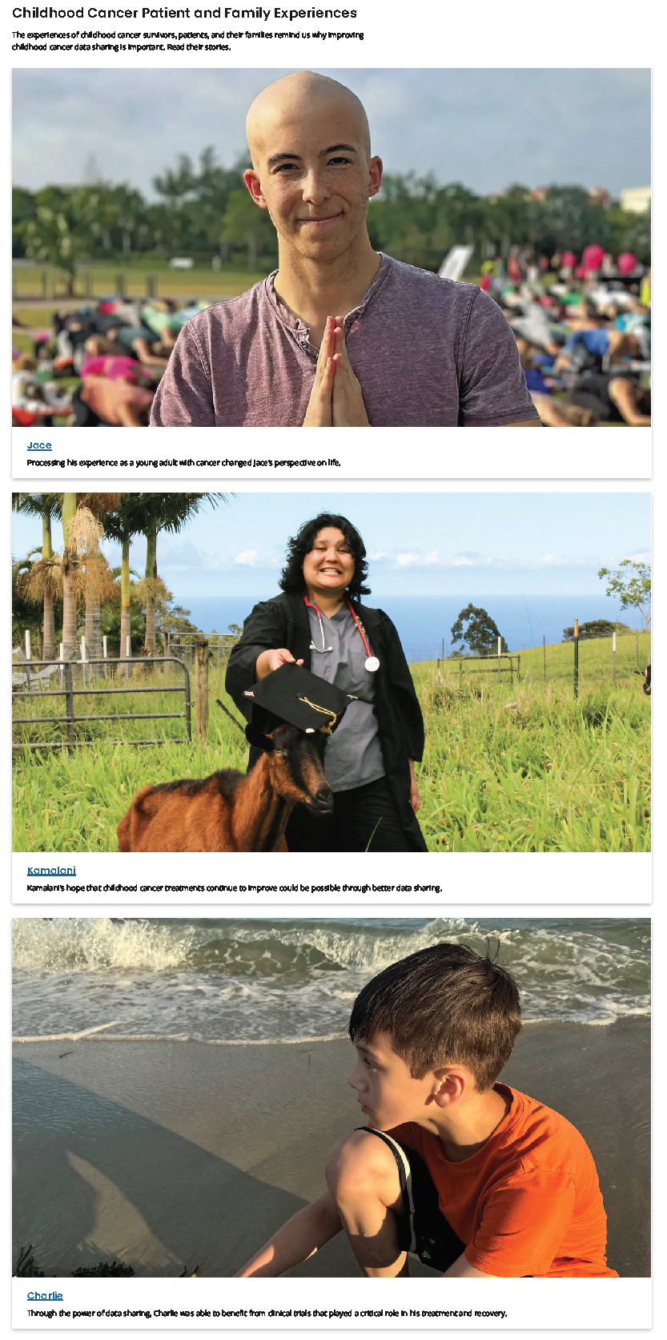
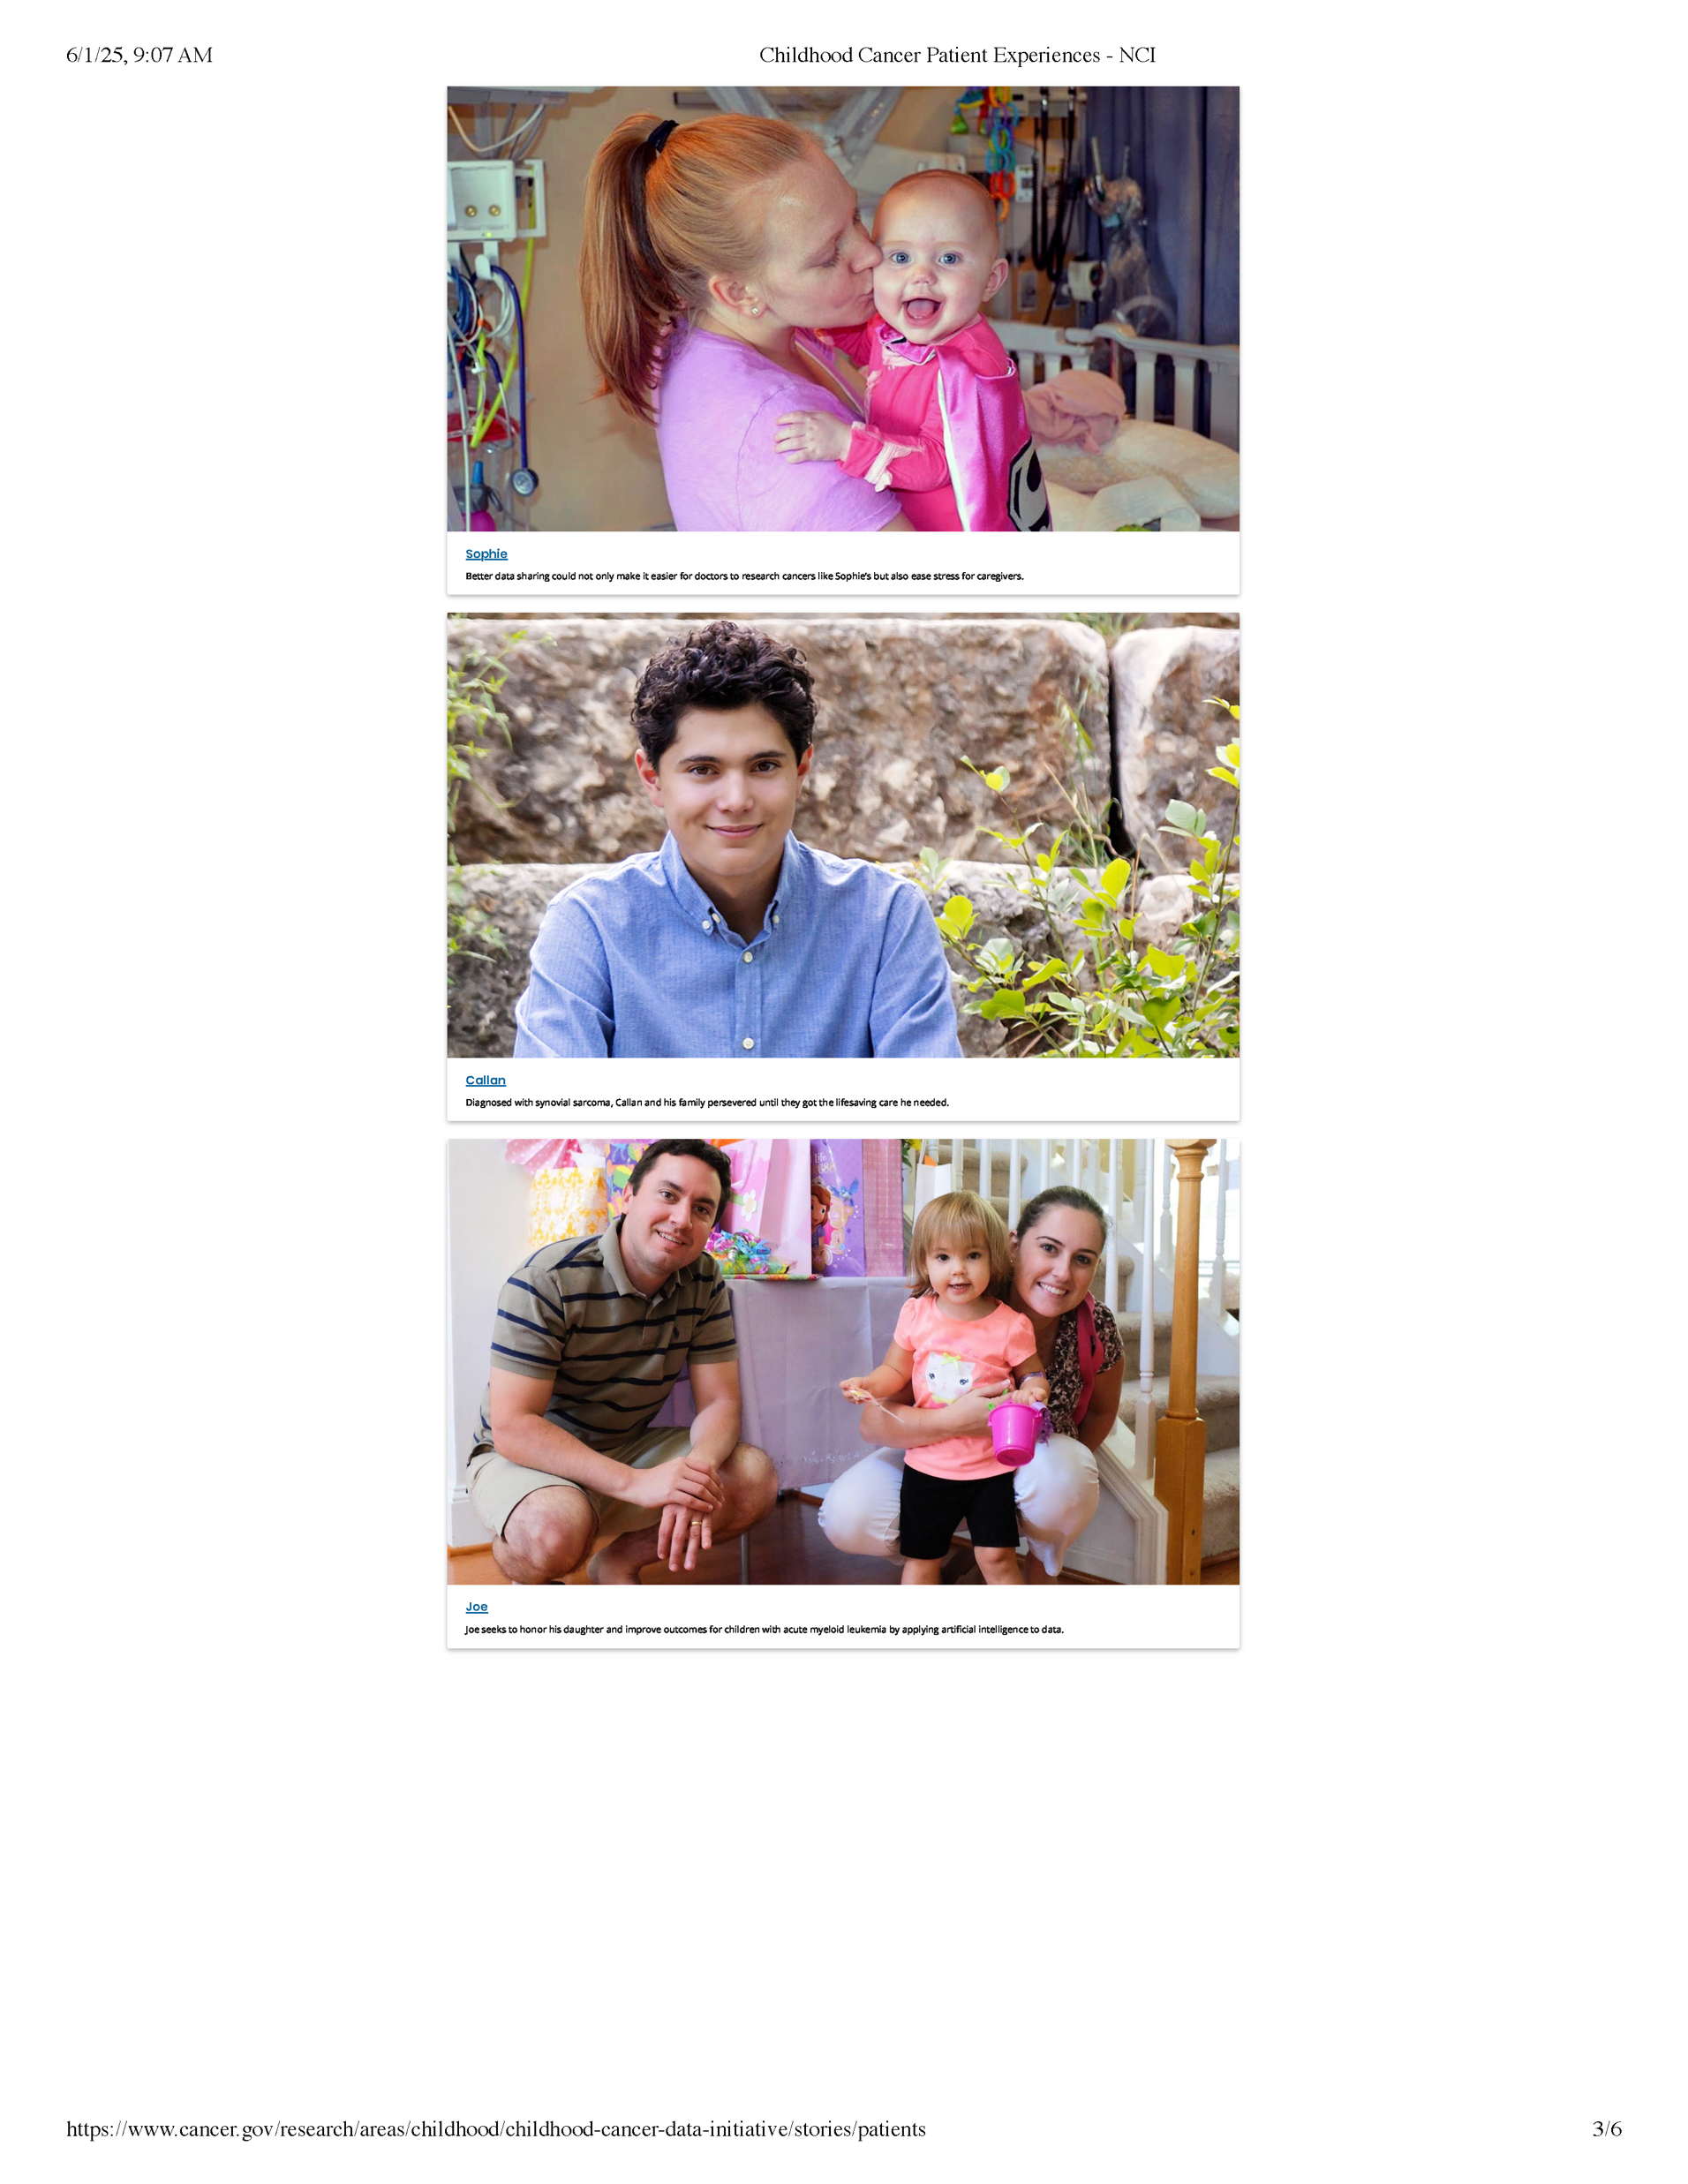


3. We provide data for many important studies
National Childhood Cancer Data Initiative
Aims to pool data for every US child, adolescent & young adult with cancer, using cancer registry data to create the largest, strongest possible dataset for research
This initiative needs data from every state. Funding for all state cancer registries is critical
America’s children with cancer
https://www.cancer.gov/research/areas/childhood/childhood-cancer-data-initiative/stories/patients

Slide 7
4. We provide data for many important public health interventions
EXAMPLES
Breast & Cervical Cancer Early Detection Program
Congressionally mandated CDC-funded screening for low-income women
Comprehensive Cancer Collaboration
Cancer coalitions in all states to reduce the burden of cancer
NCI Cancer Center Support Grants (P30)
57 NCI-designated Comprehensive Cancer Centers, whose work includes outreach to reduce cancer burden in catchment areas
World Trade Center Health Program
Covers health care for 137,000 responders and survivors
White et al, Cancer. 2017 Dec 15;123(Suppl 24):4969–4976. https://www.cancer.gov/research/infrastructure/cancer-centers

Slide 8
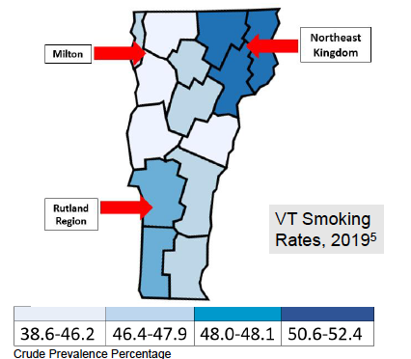
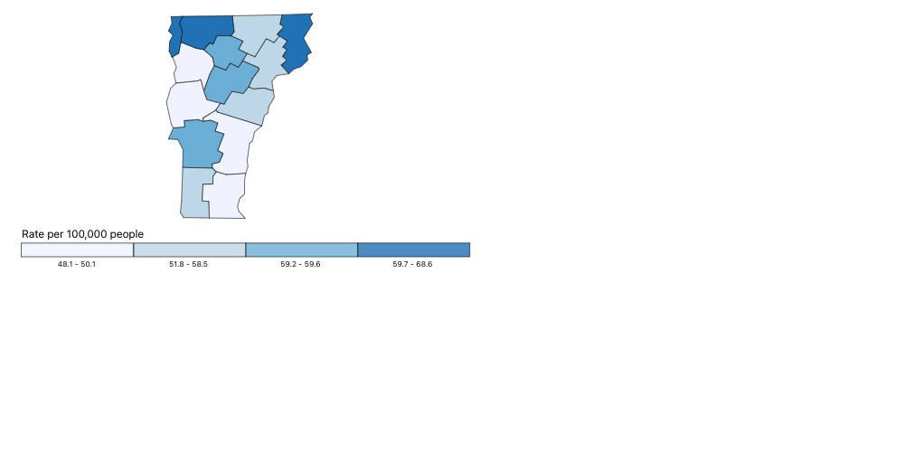
4. We provide data for many
important public health interventions
VT lung cancer age-adjusted incidence 2017-21
Lung cancer screening interventions in Vermont targeted resources to areas of greatest need, based on smoking prevalence & lung cancer incidence
United States Cancer Statistics: Data Visualizations, CDC, https://gis.cdc.gov/cancer/USCS/#/StateCountyTerritory/

Slide 9
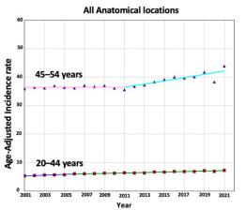
Early-onset colorectal cancer is increasing:
- in ages 45-54 by 0.7% per year
- in ages 20-44 by 1.5% per year
And the Colon Cancer Family Registry, using cancer registry data has taught us a lot about inherited cancer syndromes & early-onset cancer (>700 published research papers)
5. We identify concerning trends over time
Abboud et al. Cancers. 2025;17(9):1500 https://coloncfr.org/

Slide 10
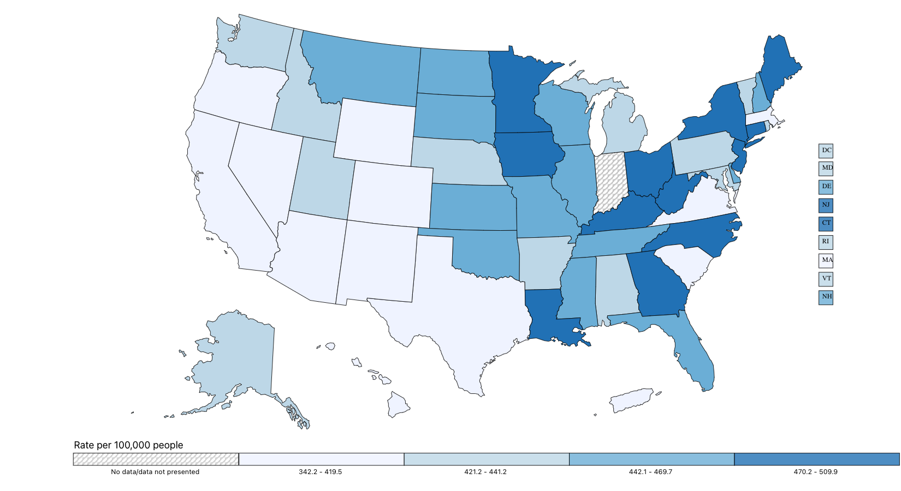
6. We identify concerning patterns
Kentucky’s cancer rate is 39% higher than New Mexico’s
https://gis.cdc.gov/cancer/USCS/#/AtAGlance/

Slide 11
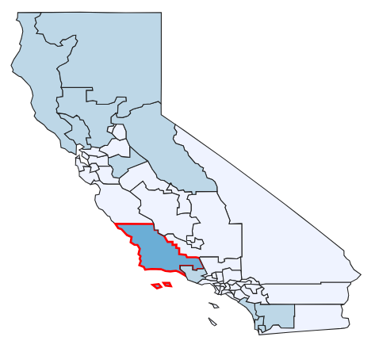
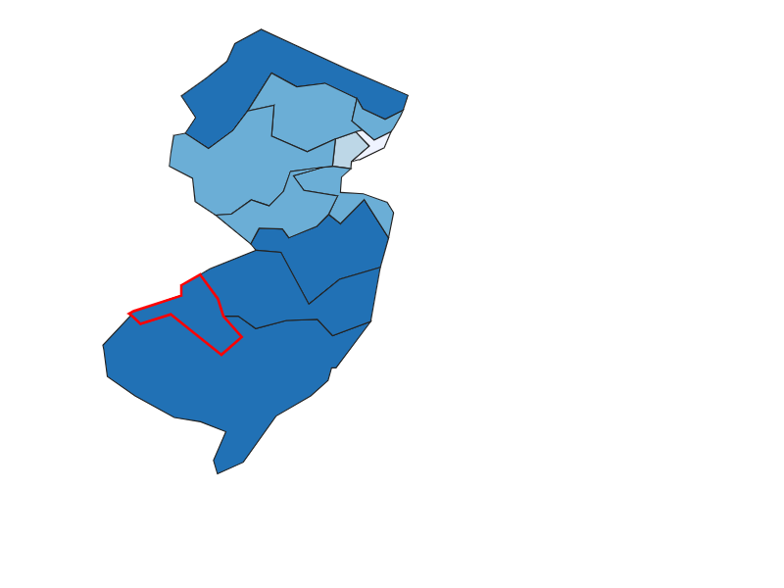
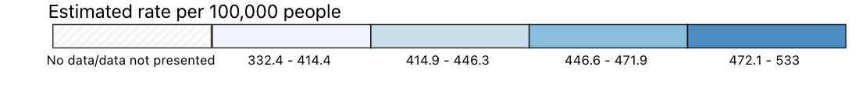
7. We inform legislators about cancer in their districts
California Congressional District 24 has the highest rate of cancer in CA - 22% higher than District 28
New Jersey Congressional District 1 has the highest rate of cancer in NJ –14% higher than District 12
https://gis.cdc.gov/cancer/USCS/#/CongressionalDistricts/

Slide 12
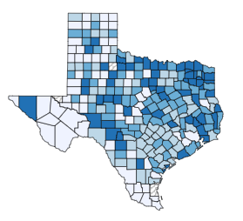
8. We inform legislators about concerning trends
Texas Cancer Registry reported to legislators on cancers before age 50, with increases in:
Early-onset uterine cancer (APC 3.5%)
Early-onset colorectal cancer (APC 2.3%)
Early-onset kidney cancer, breast cancer
APC = Annual Percent Change
https://narrative.naaccr.org/tcr-investigates-early-onset-cancer-trends/ https://gis.cdc.gov/cancer/USCS/#/StateCountyTerritory/

Slide 13

9. We inform public policy
President Trump cited cancer statistics in Feb 2025 Executive Order:
“Across 204 countries and territories, the United States had the highest age-standardized incidence rate of cancer in 2021, nearly double the next-highest rate. Further, from 1990-2021, the United States experienced an 88 percent increase in cancer, the largest percentage increase of any country evaluated.”
https://www.whitehouse.gov/presidential-actions/2025/02/establishing-the-presidents-make-america-healthy-again-commission/
Wu et al. J Hematol Oncol. 2024 Nov 29;17:119.

Slide 14
10. We provide data to investigate community cancer concerns
EG Camp LeJeune Study, North Carolina
1953-85 - US Marine Corps Base Camp Lejeune’s drinking water highly contaminated eg TCE, benzene, vinyl chloride
54 US Cancer Registries identified cancers for the study
hematological cancers, lymphoma, & cancers of esophagus, larynx, thyroid, lung
~ 1 million people exposed over 32 years
Disability & healthcare benefits provided to Veterans & families
Photo by Lance Cpl. Kyle Baskin https://media.defense.gov/2025/Feb/25/2003651598/-1/-1/0/250210-M-QX760-1375.JPG, Bove et al Environ Health 2024;23:61
Bove et al. Envir Health Perspect 2024, 132, 10: 107008 https://www.va.gov/disability/eligibility/hazardous-materials-exposure/camp-lejeune-water-contamination/

Slide 15
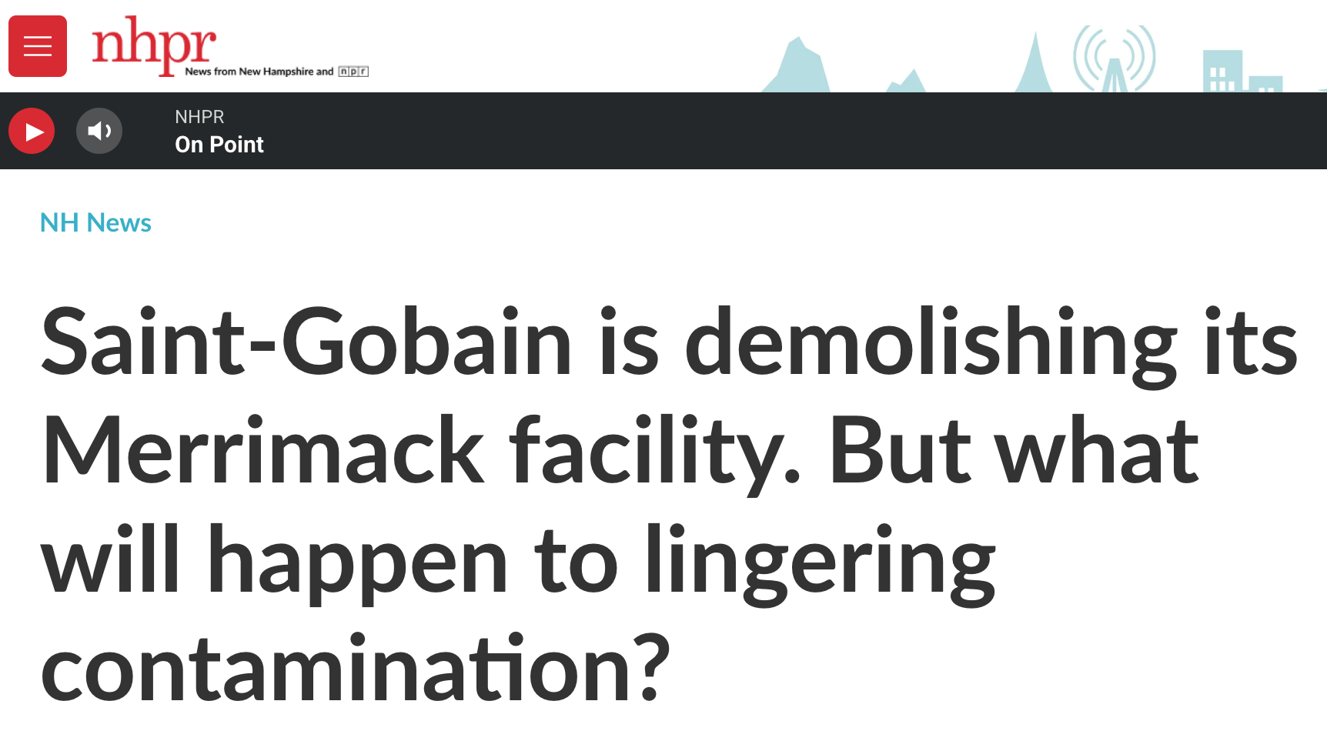
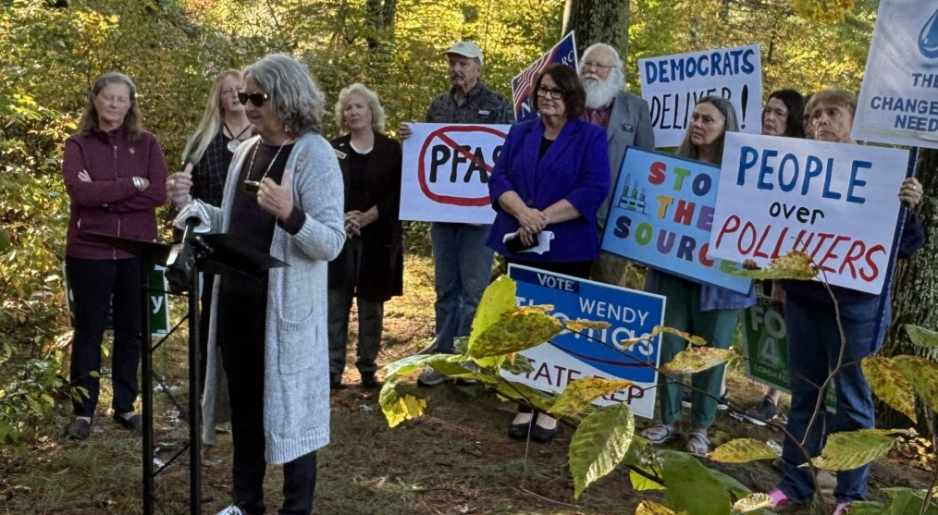
10. We provide data to investigate community cancer concerns
EG Merrimack, NH Kidney Cancer Study
PFAS manufactured in Merrimack Town, NH, entered public drinking water via air from the factory
2023 Merrimack Town kidney cancer SIR 1.42 (95% CI 1.10-1.81)
Led to State funding of pilot study to investigate it and the factory is being demolished
State Rep Wendy Thomas has dealt with “cancer that she attributes to 12 PFAS chemicals detected in her blood above the toxic limit for humans”
Article by Mara Hoplamazian, https://www.nhpr.org/nh-news/2024-12-13/saint-gobain-is-demolishing-its-facility -in-merrimack-but-what-will-happen-to-lingering-contamination https://www.dhhs.nh.gov/sites/g/files/ehbemt476/files/inline-documents/sonh/cancer-incident-report-merrimack-nh-january2023.pd
https://newhampshirebulletin.com/2025/01/30/those-harmed-by-forever-chemicals-have-six-years-to-sue-in-nh-lawmakers-want-more-time/

Slide 16
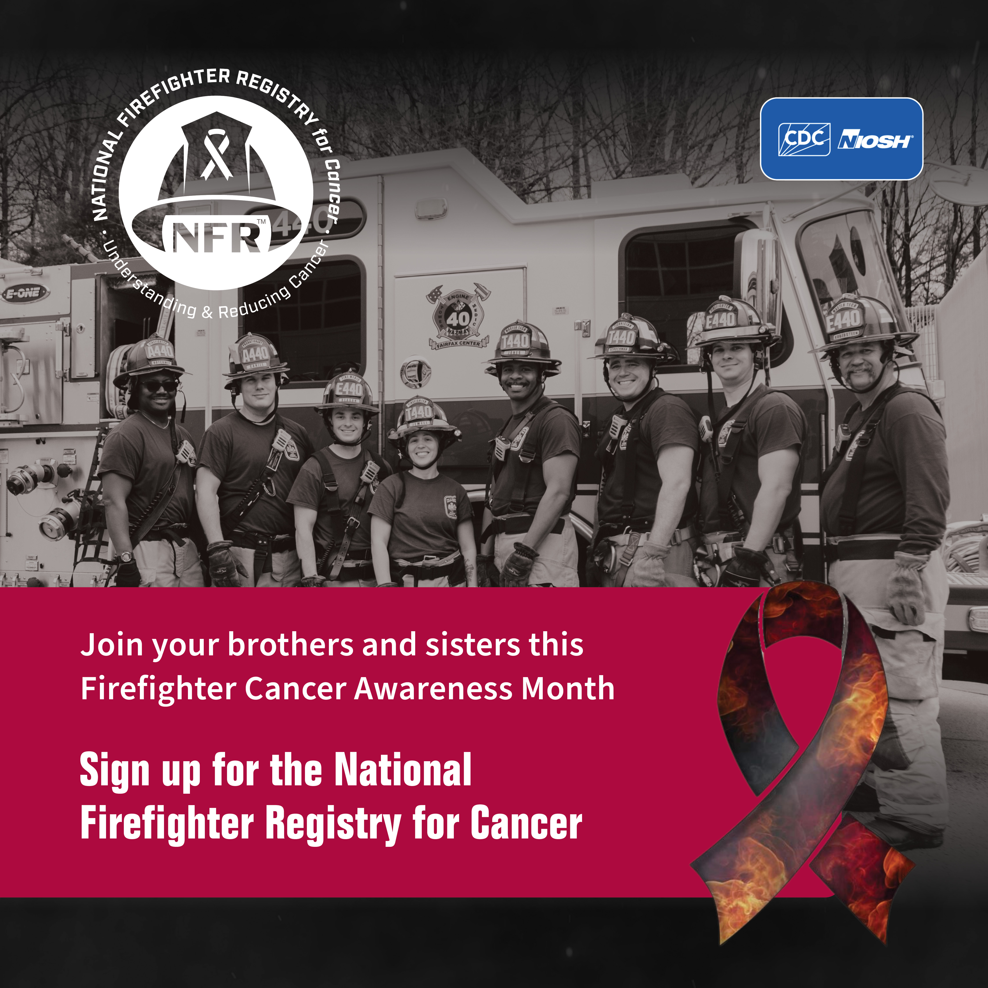
11. We identify people at greater risk from cancer
Firefighters are at greater risk of cancers
  Pleura (60% higher risk), testis (34%), thyroid (22%), melanoma (21%), prostate (15%), colon (14%), bladder (12%), rectum (9%)
Firefighter Cancer Registry Act of 2018
  Began the National Firefighter Registry for Cancer, run by NIOSH
This initiative needs data from every state.
Funding for all state cancer registries is critical
https://www.cdc.gov/niosh/firefighters/registry/cancer-awareness-month-toolkit.html Jalilian, Int J Cancer 2019; 145; 10; 2639-2646 https://nihrecord.nih.gov/2023/08/18/fire-department-celebrates-70th-anniversary Photo Mat Chibbaro
https://www.cdc.gov/niosh/firefighters/registry/index.html https://gc.nh.gov/bill_status/legacy/bs2016/billText.aspx?id=856&txtFormat=html&sy=2023

Slide 17

11. We identify people at greater risk from cancer
FANS Study (PI Scarlett Gomez)
Investigates the unexpectedly high rates of lung cancer in
Female Asian Never Smokers
Usually, 15% of people diagnosed with lung cancer are ‘never smokers’
But 57% of Asian American women diagnosed with lung cancer have never smoked
DeRouen, JNCI, Volume 114, Issue 1, 2022, P78–86
https://fansstudy.ucsf.edu/home

Slide 18
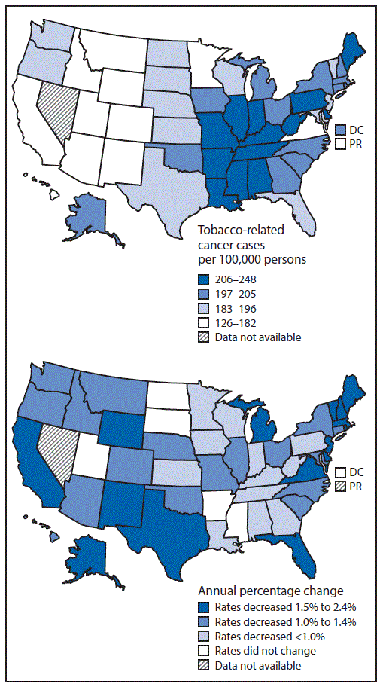
Tobacco causes at least 12 types of cancer
These cancer rates are very different on the east and west sides of the country
Tobacco-related cancer incidence has decreased significantly in 44 states
12. We show if investments in public health are working
Age-adjusted rate of tobacco-related cancers (2009–2013) and trends in rates (2004–2013), by state — NPCR and SEER, United States
https://www.cdc.gov/mmwr/volumes/65/wr/mm6544a3.htm

Slide 19
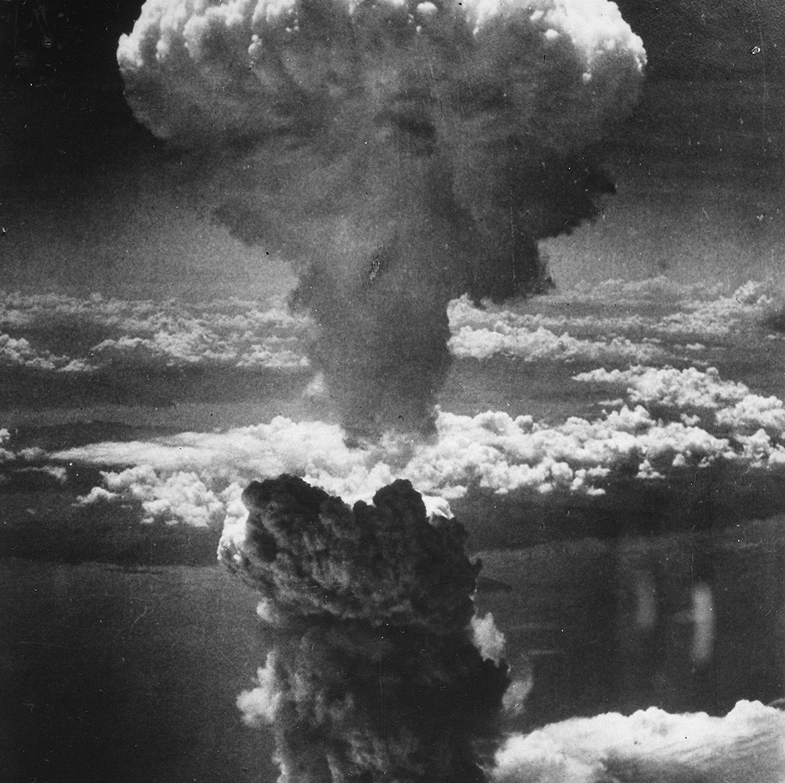
13. Registries help identify causes of cancer
Our understanding of cancer risk due to ionizing radiation was based on cancer registries in Hiroshima and Nagasaki, Japan ….
Thompson, Radiat Res 1994, 137 (2s): S17–S67.
The atomic cloud rising over Nagasaki, Japan. National Archives ID 535795 - https://www.archives.gov/news/topics/hiroshima-nagasaki-75

Slide 20
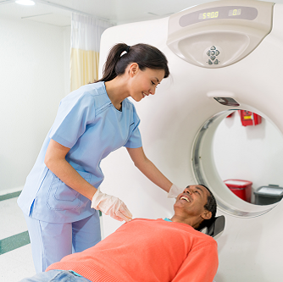
13. Registries help identify causes of cancer
… 80 years on, minimizing radiation exposure from CT scans is being prioritized.
~ 4870 cancers may result from the 4 million CT scans done every year on US children.
Miglioretti, et al. JAMA Pediatr. 2013, 167, 700–707.
Budoff et al Circulation. 2006;114(16):1761-179117015792

Slide 21
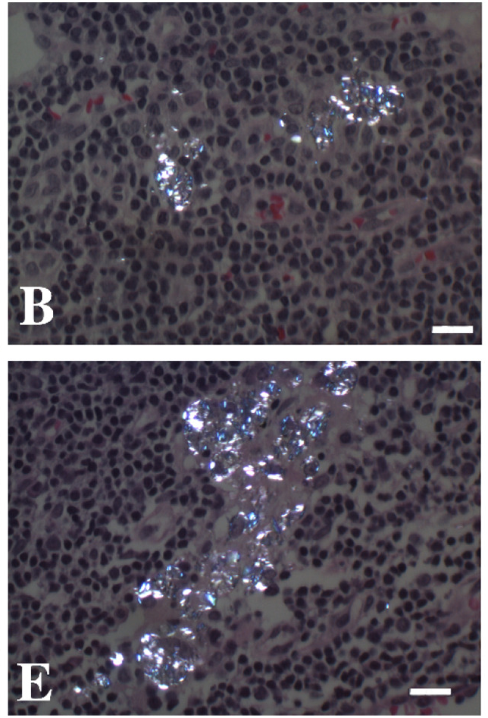
13. Registries help identify causes of cancer
Ovarian cancer studies -
1992 - talcum powder linked to ovarian cancer
Talc contaminated with asbestos is classified as a carcinogen (IARC Group 1)
Talc alone is classified as a probable carcinogen (IARC Group 2A)
2023 - Johnson & Johnson discontinued talc-based baby powder
Talc in ovarian cancer
lymph nodes
Harlow et al 1992 Obstetrics and Gynecology 1992-07; 80 (1), 19-26 https://monographs.iarc.who.int/list-of-classifications
Johnson et al Gynecologic Oncology 2020, 159(2); 527-533 Cramer et al, Epidemiology. 2016 Apr 1;27(3):334–346

Slide 22
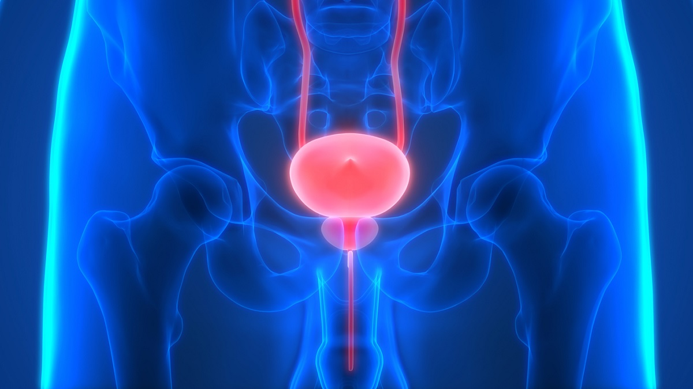
13. Registries help identify causes of cancer
Bladder cancer studies -
Exposure to arsenic in drinking water is linked to bladder cancer
  - even at low concentrations
2021 NH law reduced arsenic MCL in drinking water from 10 to 5 ppb….
… and led to a large birth cohort study of early life exposures to arsenic & other environmental health risk factors
Baris et al J Natl Cancer Inst. 2016 May 2;108(9):djw09 https://www.cdc.gov/bladder-cancer/about/index.html
https://www.des.nh.gov/news-and-media/blog/more-protective-arsenic-standard-will-reduce-risk-many#
New Hampshire Birth Cohort Study grant: 5UG3OD023275-09 PI Karagas https://deepai.org/machine-learning-model/text2img

Slide 23
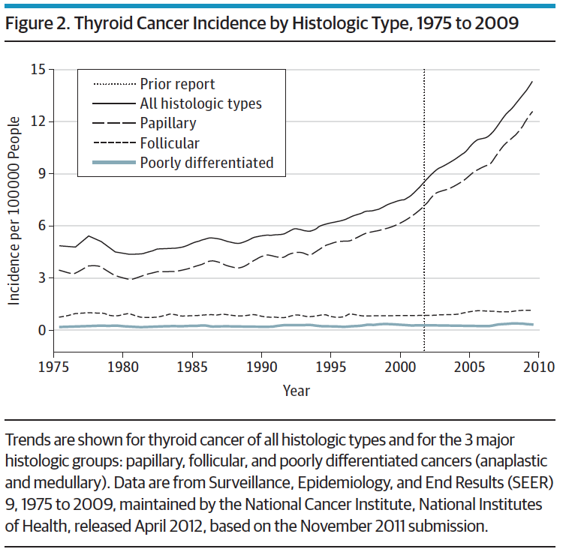
13. Registries help identify causes of cancer
Thyroid cancer studies -
Increasing thyroid cancer in US first reported through Connecticut Cancer Registry after Chernobyl disaster,¹ driven by small papillary thyroid cancer²
Mortality is stable
Radiologic imaging is playing a role in diagnosis or causality³
Cramer. Surgery 2010. 148(6):1147-1153
1. Mangano. Eur J Cancer Prev, 1996, 5(1);75-81 2. Davies & Welch, JAMA 2006, 295:2164-2167 3. Zhang. Eur J Cancer Prev. 2015;24(5):439–446

Slide 24
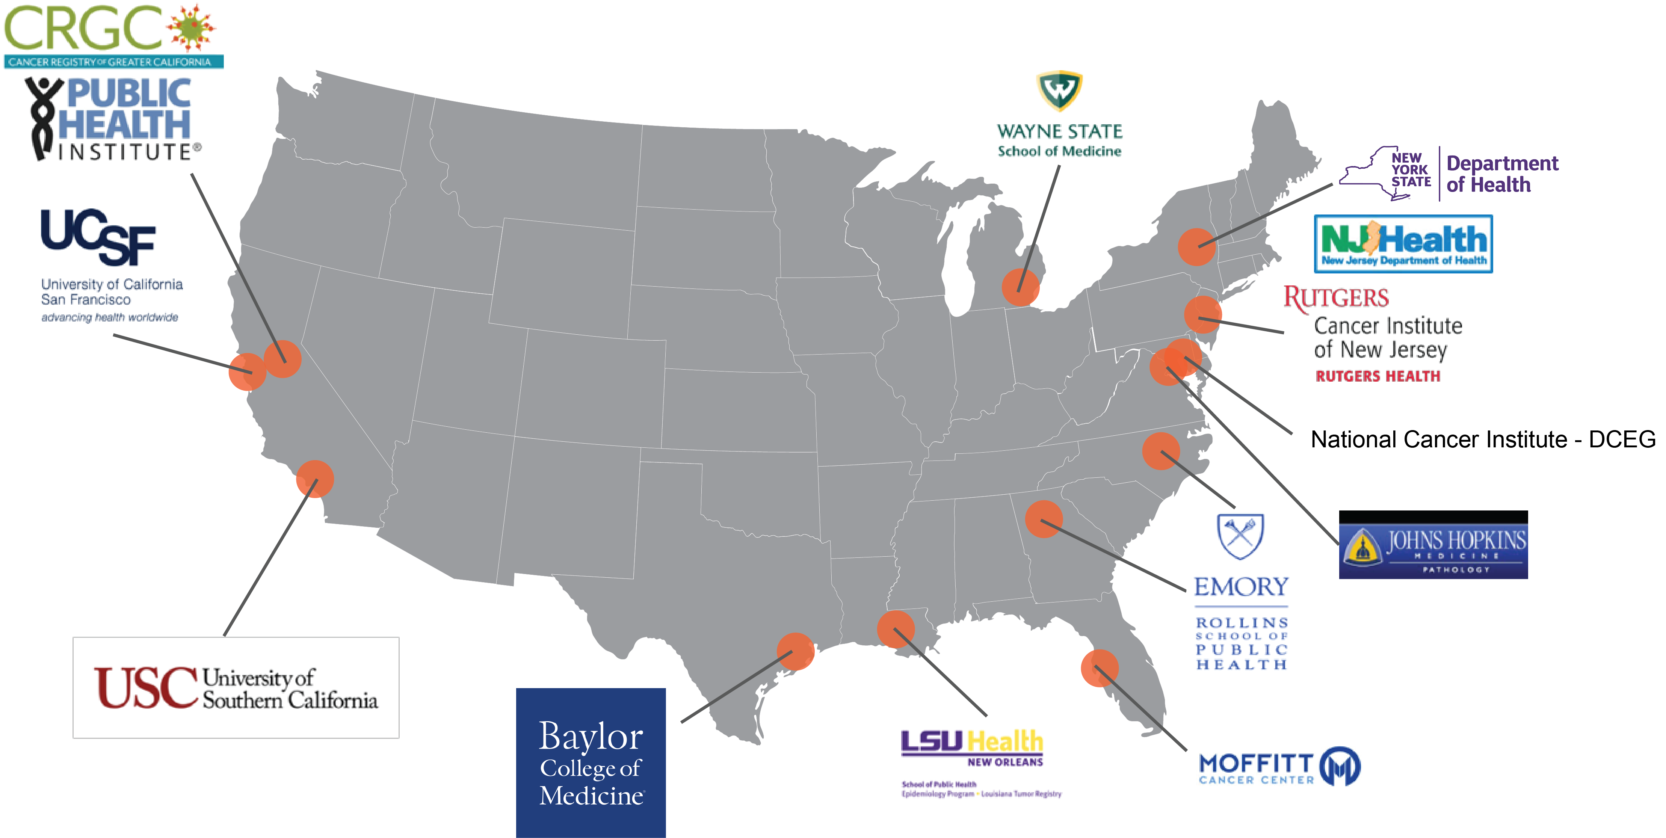
14. We help understand how complex cancer is
The RESPOND cohort
The largest study ever of prostate cancer health in 12,500 African American men
Participants identified through cancer registries
U01CA287036 – PI Haiman - Identifying factors associated with prostate cancer progression and survival in African American men: The RESPOND Cohort

Slide 25
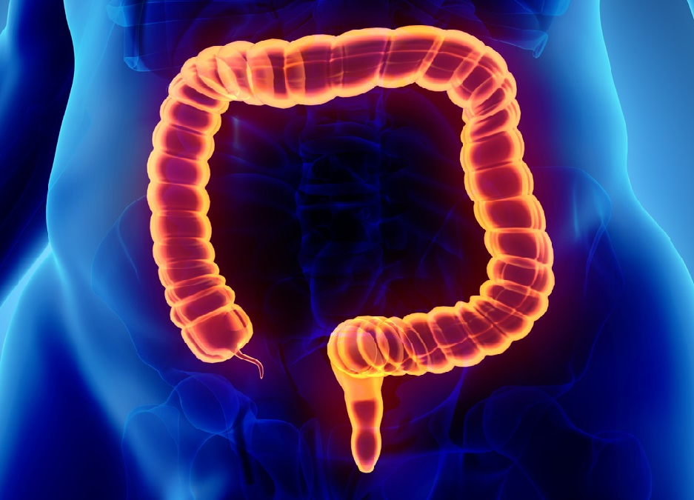
15. Our data is cited in key clinical guidelines
Breast cancer screening 2024
  All women screen every other year from 40 (vs. start between 40-50)
Colorectal cancer screening 2021
  Start to screen from 45 (lowered from 50)
Lung cancer screening 2021
  Annual low-dose CT in adults 50-80y with a 20 pack-year smoking history and currently smoke or have quit within past 15 years.
USPSTF – US Preventive Service Task Force - https://www.uspreventiveservicestaskforce.org/uspstf/recommendation-topics/uspstf-a-and-b-recommendations

Slide 26

15. Our data is cited in key clinical guidelines
Skin cancer: screening 2023
Breast Cancer: Medication Use to Reduce Risk 2019
BRCA-Related Cancer: Risk assessment, genetic counselling & testing 2019
Pancreatic Cancer: Screening 2019
Cervical Cancer: Screening 2018
Prostate Cancer: Screening 2018
Skin Cancer Prevention: Behavioral Counseling 2018
Ovarian Cancer: Screening 2018
Thyroid Cancer: Screening 2017
Oral Cancer: Screening 2013
USPSTF – US Preventive Service Task Force https://www.uspreventiveservicestaskforce.org/uspstf/recommendation-topics/uspstf-a-and-b-recommendations
https://www.cdc.gov/skin-cancer/symptoms/index.html

Slide 27

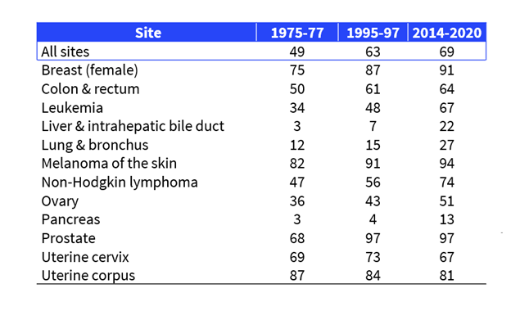
16. We show you if cancer treatments
are working
EXAMPLE
Compared to the 1970’s, twice as many patients (67% v 34%) now live more than 5 years after leukemia diagnosis
American Cancer Society Facts and Figures https://www.cancer.org/content/dam/cancer-org/research/cancer-facts-and-statistics/annual-cancer-facts-and-figures/2025/slideshow-2025-cancer-facts-and-figures-acs.pptx

Slide 28
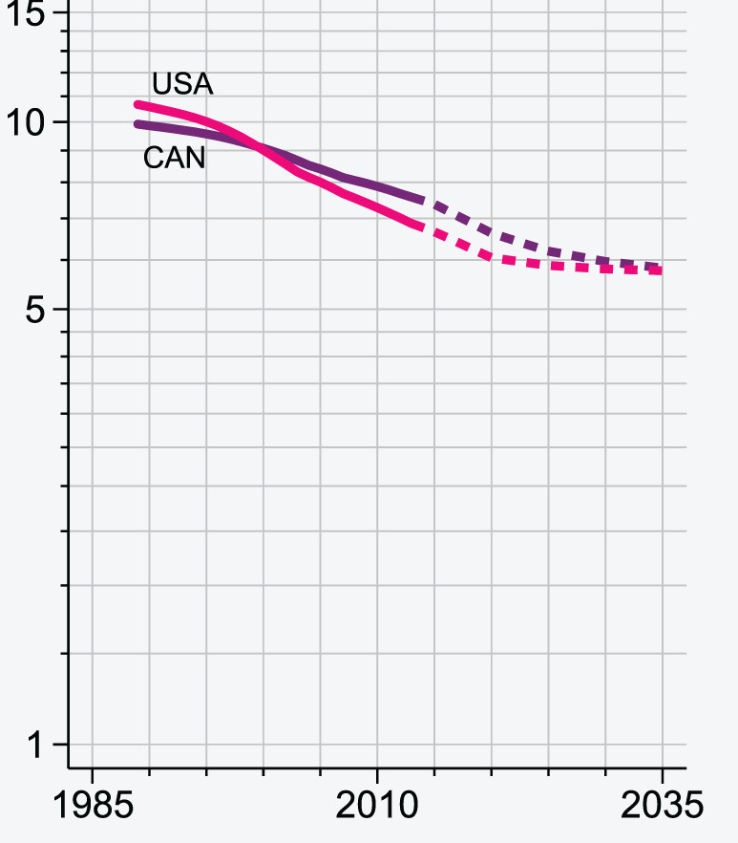
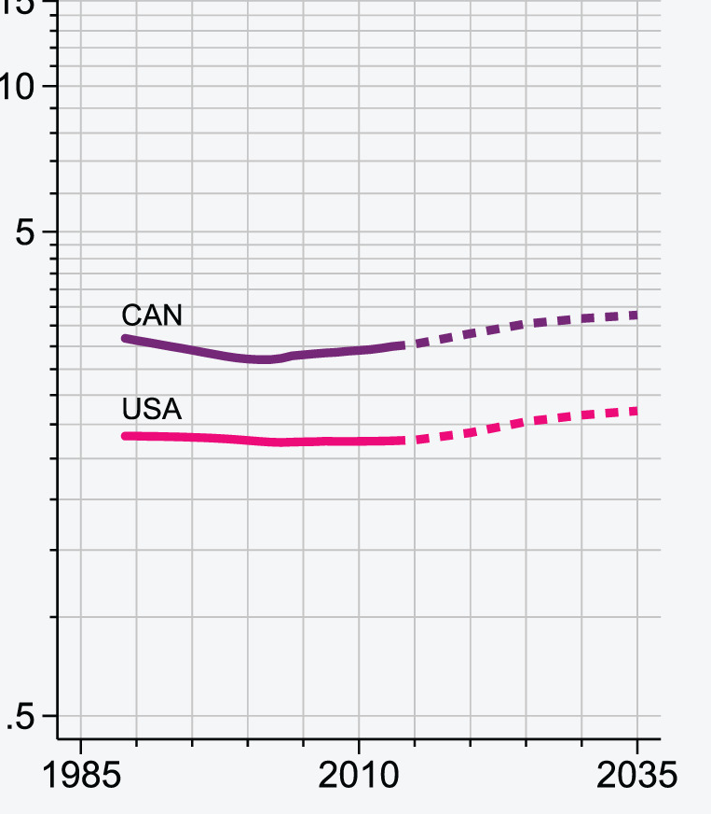
17. We help plan for the future
Colon cancer
Despite decline in overall colorectal cancer mortality rate (2013-2035), there are opposite trends for colon and rectal cancer
The number of rectal cancer deaths will double by 2035 in the U.S.
Age-standardized mortality/100,000/year
Rectal cancer
Araghi et al. Int J Cancer. 2019 Jun 15;144(12):2992-3000

Slide 29
17. We help plan for the future
US trends in cancer incidence, Females and males, 1975-2021
Cancer surveillance helps plan for the future but national and state cancer patterns are not necessarily the same
EXAMPLE
  US liver cancer is decreasing by 1.2% each year
  But in Maine, it’s increasing by 2.7%
Every state must have a cancer registry
American Cancer Society Facts and Figures https://www.cancer.org/content/dam/cancer-org/research/cancer-facts-and-statistics/annual-cancer-facts-and-figures/2025/slideshow-2025-cancer-facts-and-figures-acs.pptx

Slide 30
Our data are the basis for much of what we know about cancer and how to fight it.
Without cancer registration in every state to tell us what’s going on, we are blindfolded in this fight.
https://monographs.iarc.who.int/wp-content/uploads/2019/12/OrganSitePoster.PlusHandbooks.pdf © International Agency for Research on Cancer 2025, Accessed May 15, 2025

