Slide 1
2024 Data Changes
Janine Smith, BS, ODS-C
California Cancer Registry

Slide 2
Topics
Changes Specific to California – CCR Volume 1
Major Standard Setter Changes
ICDO-3.2 Updates and Reportability
New and Revised Data Items
Staging Updates
STORE Surgery Code Changes

Slide 3
CCR Volume 1
2024 Data Changes Specific to California

Slide 4
Changes Specific to California
CCR Expectations for collecting information for non-analytic cases
CCR Reportability Guide
Text Documentation
New Sections/Deleted Section to Volume 1
Visually Edited Data Items
Volume 1 has been updated to reflect standard setter changes

Slide 5
CCR Expectations – Collecting Information for Cases Diagnosed and Treated Elsewhere
Non-analytic cases continue to provide value to the state data set, as they fill in the gaps of information that are not provided by analytic cases. The CCR continues to monitor the value of non-analytic case reporting and will adjust requirements in the future should something change.
The CCR has updated the guidelines for reporting information on non-analytic cases based on questions and feedback received from the registry community.
They can be found in Section I.1.8 Cases Diagnosed and Treated Elsewhere in CCR Volume 1.
Notes:
Non-analytic cases are a recurring topic for these data changes presentations! In the last several years, we have tried to clarify reportability of the Class 30 cases. But we do continue to get questions about non-analytic cases in general, how much information needs to reported, and if there is a “bare-minimum” of information that can be reported.
Trust me, we feel your pain and understand the burden reporting these cases places on the facilities.
Earlier this year, we conducted an audit of Class 30 cases to assess the value these cases are providing. And what we found was that they continue to provide value to the state data set because they fill in the gaps of information that are not provided by analytic cases. So for now, we need to continue to collect these cases.
But we have updated the expectations on collecting information for these cases.
They can be found in section 1.1.8 of CCR Volume 1.
A data alert was sent out earlier this year to notify registrars in California that these expectations are effective immediately.
We have incorporated these changes into CCR Volume 1 for 2024. See section I.1.8 Cases Diagnosed and Treated Elsewhere.

Slide 6
CCR Expectations – Collecting Information for Cases Diagnosed and Treated Elsewhere
Please use the following guidelines when reporting non-analytic cases to CCR.
Report all information included in your facility’s medical record. If the electronic medical record system used by your facility can view the medical records from outside facilities, it is not necessary to look for missing information in those outside records, although a facility may choose to do so.
Notes:
All information in your facility’s medical record DOES include any diagnostic workup or treatment done outside your facility that has been scanned into your EMR.
However, we do not expect you to go on a treasure hunt to find information that is not readily available in your facilities medical record!

Slide 7
CCR Expectations – Collecting Information for Cases Diagnosed and Treated Elsewhere
Please use the following guidelines when reporting non-analytic cases to CCR.
All information reported must be coded and documented in the appropriate text fields.
Even though information for many required data items might not be available, all the data items must be completed.
If necessary, enter the codes for UNKNOWN or NONE.
Notes:
What you DO report needs to be fully documented in text and coded. We expect high-quality on anything that is reported because it will be used to improve data in the central registry.

Slide 8
CCR Expectations – Collecting Information for Cases Diagnosed and Treated Elsewhere
For definitions of non-analytic cases and which non-analytic cases are reportable to CCR, see CCR Volume 1.
There are NO CHANGES for 2024 on which cases are reportable.
The CCR will continue to monitor the value of non-analytic case reporting and will adjust requirements in the future should something change.

Slide 9
CCR Reportability Guide (Section II.1._)
Updated to reflect ICD-O-3.2 changes for 2024
More examples of reportable diagnoses have been added to the section to better align with the SEER Manual.
These are NOT newly reportable.
They have been added to provide clarification on terms/diagnoses that are frequently questioned by registrars.

Slide 10
Text Documentation Guidelines
Treatment start dates MUST be documented in text
This has ALWAYS been a CCR Requirement.
It is also an NPCR requirement.
A statement has been added to Volume 1 Section VI.1.2 First Course of Treatment – Data Entry.
A treatment date that is coded but is not also documented in text is considered a discrepancy!

Slide 11
Text Documentation Guidelines
Scope of Regional Lymph Node Surgery
MUST be supported by text
This has ALWAYS been a CCR Requirement as all codes must be supported by text.
CCR Volume 1 and Appendix T have been updated to explicitly include this in the check-list of information for Surgery and Operative text fields.
Document in text (preferably Operative Text or Surgery Text) the LN Procedure(s) done as stated on the operative report.

Slide 12
Text Documentation Guidelines
Scope of Regional Lymph Node Surgery MUST be supported by text
Provide enough information to support your code
Statement of LN biopsy or SLN bx and/or Lymph Node Dissection must be documented in text for codes 1-7.
Do not assume results from the path report alone is enough information to support the code.

Slide 13
Scope of Regional LN Surgery Text and Codes
Example 1
What is Scope of Regional LN Surgery?
Operative Text: blank
Surgery Text: L breast mastectomy
Path Text: L breast IDC, 1.1cm Gr 2, 0/5 SLNs, 0/2 Non-SLNs
Assign Code 5. There is NOT enough information to assign Scope of Regional LN surgery to 2. Given the information in the path text, it should probably be coded to 2 or 6, but we have no way of knowing since there is no information in Operative or Surgery text about the LN surgery performed.
Review the operative report to see if a SLN bx is documented. If so, update the operative/surgery text and assign the appropriate code (see examples 2 and 3).
If the operative report does not indicate the type of LN procedure, assign Scope of Reg LN Surgery based on the number of LNs examined.
Notes:
I want to go through a few examples that explain how the text and the code assigned need to align.

Slide 14
Scope of Regional LN Surgery Text and Codes
Example 2
What is Scope of Regional LN Surgery?
Operative Text: blank
Surgery Text: L breast mastectomy, sentinel LN bx
Path Text: L breast IDC, 1.1cm Gr 2, 0/5 SLNs, 0/2 Non-SLNs
Assign Code 2. ONLY a SLN bx was documented in text and there was no mention of an additional Regional Lymph Node dissection. The presence of non-sentinel lymph nodes does not automatically mean that a regional LN dissection procedure was done. This text does NOT support code 6.

Slide 15
Scope of Regional LN Surgery Text and Codes
Example 3
What is Scope of Regional LN Surgery?
Operative Text: blank
Surgery Text: L breast mastectomy, SLN bx, Ax LND
Path Text: L breast IDC, 1.1cm Gr 2, 0/5 SLNs, 0/2 Non-SLNs
Assign Code 6 since BOTH a SLN bx and Axillary Lymph Node dissection were documented.

Slide 16
For more tips on coding Scope of Regional LN Surgery, see CCR Q-Tip 2024-01 in FLccSC:
“Scope of Regional Lymph Node Surgery –
Coding Tips for Sentinel Lymph Node Biopsies”
If you do not have a FLccSC user account, use the link below to access the FLccSC login page and click the box “New Users – Register here” in the bottom right-hand corner and set up your profile. http://cas.fcdslms.med.miami.edu

Slide 17
New and Deleted Sections in Volume 1
New Sections
V.3.4 Cancer PathCHART Site-Morphology Combination Standards
VI.2.4.4 Breast Reconstruction
Renumbered/Deleted Sections
V.5.1 Tumor Size Clinical
V.5.2 Tumor Size Pathologic
V.5.3 Tumor Size Summary – renumbered to V.5.1
Notes:
For those of you navigating through CCR Volume 1, there have been two new sections added and two sections deleted to adhere to standard setter changes for 2024.

Slide 18
Visual Editing / Accuracy Rates
CCR will be moving away from the current definition of Visual Editing and Accuracy Rates.
As of June 1, 2024, reporting facilities will no longer receive reports related to these quality measures. CCR is working to evolve our definition of Visual Editing to better support education and overall data quality.
A Data Alert went out on 5/31/2024 communicating this information.
Due to these changes, there will not be a Visually Edited Data Items list for 2024.

Slide 19
Major Standard Setter Changes

Slide 20
No major changes to the following…
Solid Tumor Rules
Hematopoietic and Lymphoid Neoplasms Manual and Database

Slide 21
ICD-O-3.2 Updates for 2024 (Highlights)
See ICD-O-3 Implementation Guidelines located on the NAACCR website for the comprehensive set of ICD-O-3.2 Updates for 2024.
Use of these guidelines is required for determining reportability and accurate coding.
2024 ICD-O-3.2 Update Tables 1 and 2 (Numeric and Alpha) include all changes to ICD-O-3.2 made after the 2023 update and are effective for cases diagnosed 1/1/2024.
This presentation only includes the more notable changes
Notes:
This presentation only includes the more notable changes. For the comprehensive list of updates, see the implementation guidelines by following the link in this slide. As a reminder, use of the guidelines is required for determining reportability and accurate coding.
The 2024 Update tables include all changes to ICD0 made after the 2023 update and are effective for cases diagnosed 2024 and forward.

Slide 22
ICD-O-3.2 Updates for 2024 (Highlights)
Not many changes for 2024
NO New Codes!
ONE behavior change
SOME but not ALL of the changes have been incorporated into the Solid Tumor Rules
The current Solid Tumor Rules, the Hematopoietic and Lymphoid Neoplasm Coding Manual and Database, and the International Classification of Diseases for Oncology, Third Edition, Second Revision Morphology (ICD-O-3.2) are the standard references for histology codes.
Notes:
Thankfully, there are not many changes for 2024.
First off, there are NO new codes!
There was only one behavior change to a code and we will get to that on the next slide.
All the rest were new terms, but not many compared to prior years. The Update table is only about 2.5 pages long this year.
I wanted to point out that some (most) of the changes have been incorporated into Solid Tumor Rules, but not all of the them. On inspection I saw a few that did not make it over for one reason or another and the non-reportable terms are not be in there. The moral of the story is that you need to use ICDO in conjunction with solid tumor rules and the Heme manual and database when determining reportability and assigning histology codes.

Slide 23
ICD-O-3.2 Updates for 2024 (Highlights)
Newly Reportable for Testis ONLY (C62_)
9104/3 Placental site trophoblastic tumor of testis
Behavior changes from 1/ to /3 for cases diagnosed 1/1/2024 forward
* This is NOT in solid tumor rules
New valid codes for Penis (C60_) and Scrotum (C632)
8085/3 Squamous Cell carcinoma, HPV-associated
8086/3 Squamous Cell carcinoma, HPV-independent
Effective for cases diagnosed 1/1/2024 forward
Notes:
The two “big” changes for 2024 are on this slide.

Slide 24
SEER Site/Histology Validation List
Has now been replaced by the 2024 Cancer PathCHART ICD-O-3 Site Morphology Validation List
Notes:
Also note the SEER Site/Histology Validation List has been replaced starting in 2024.

Slide 25
New/Revised Data Items

Slide 26
New/Revised Data Items Effective 1/1/2024
Breast Reconstruction (discussed with STORE surgery code changes) New
Tumor Size Clinical and Tumor Size Pathologic no longer collected 1/1/24 forward
Tumor Size Summary will continue to be collected
SSDIS:
Brain Primary Tumor Location (Brain V9 schema) New
SEER SSF1 has changed from a 1-digit code to a 2-digit code, added new codes
Brain Molecular Markers (many new codes)
P16 (now collected for Vulva V9 schema)
Notes:
Breast Reconstruction is a new data item for 2024 and I will discuss that later in the presentation.
As I mentioned earlier, Tumor Size Clinical and pathologic are being retired and will no longer be collected.
There have also been several SSDI changes.
First, there is a new SSID for the Brain version 9 schema called Brain Primary Tumor Location
SEER Site specific factor 1 has been changed from a 1-digit to a 2-digit code and some new codes have been added
Many new codes have been added to Brain Molecular Markers which is collected for the Brain schemas
And p16 is now collected for the Vulva v9 schema

Slide 27
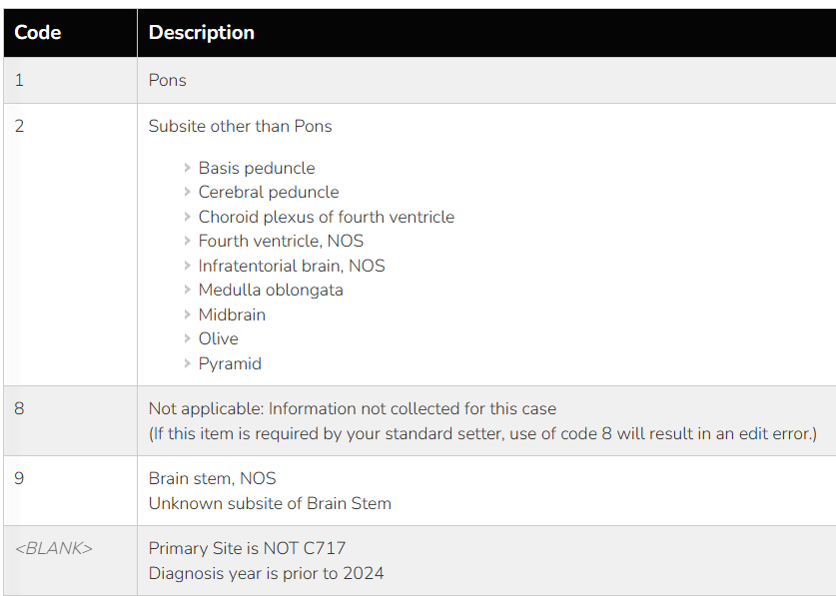
Brain Primary Tumor Location – New Data Item
New SSDI for Brain v9 Schema
NAACCR Item #3964
Required by CCR for cases diagnosed 2024+
Needed to distinguish between the Pons and all other subsites within the Brain Stem (C717)
Radiology reports and physician’s notes are the best sources to determine the appropriate code
Needle Biopsies and surgery are usually too dangerous for these types of tumors

Slide 28
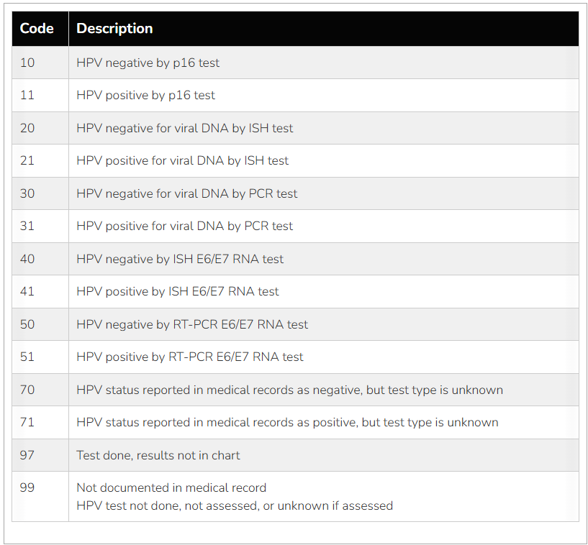
Changes to SEER Site Specific Factor 1
NAACCR Item #3700
Changed from 1-digit to 2-digit code
Codes added to capture HPV Positive or Negative by p16 test (codes 10, 11)
This is a big change in instructions for 2024
In 2023 and earlier, p16 tests were NOT recorded in this data item
Codes 10-51 are hierarchical – assign the highest applicable code
Separate codes for HPV status reported as negative vs positive, but test type unknown (codes 70, 71)
New code to indicate test done, results not in chart (code 97)
Notes:
Hierarchical codes - If an additional HPV test is done in addition to p16, code the HPV test results in this data item

Slide 29
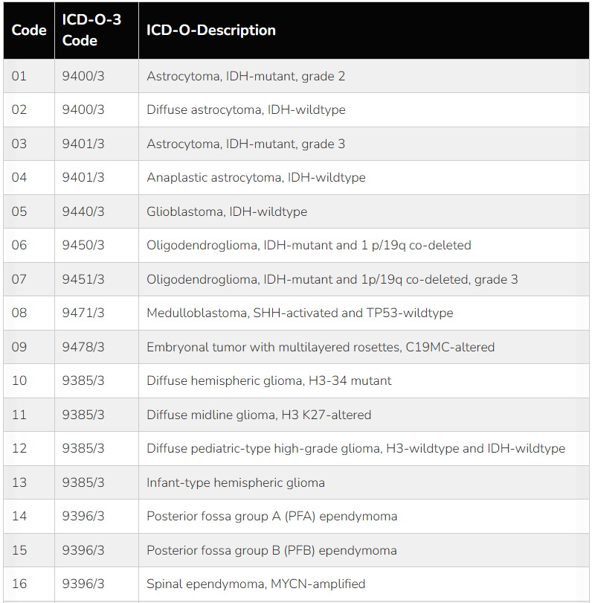
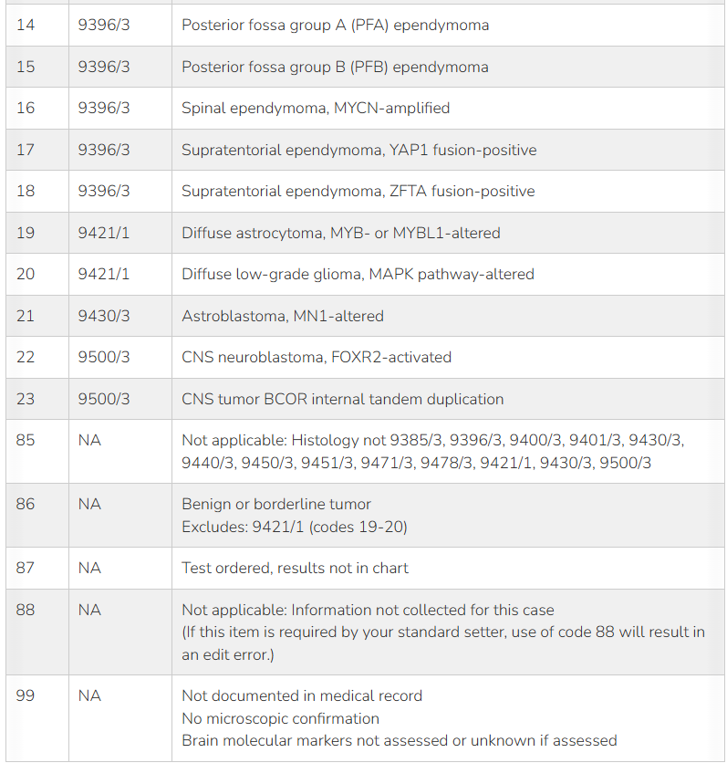
Changes to Brain Molecular Markers
NAACCR Item #3816
Codes 10-23 are new and applicable for cases diagnosed 2024+
The code table now has a column for ICD-O-3 code to make it easier to identify the codes applicable to the case
Notes:
You can use the new ICD-O-3 column in the table to quickly identify any codes that are applicable to your case.

Slide 30
Staging Updates

Slide 31
New AJCC Version 9 Protocols for 2024
Vulva Version 9
Neuroendocrine Tumors of the Stomach Version 9
Neuroendocrine Tumors of the Duodenum and Ampulla of Vater Version 9
Neuroendocrine Tumors of the Jejunum and Ileum Version 9
Neuroendocrine Tumors of the Appendix Version 9
Neuroendocrine Tumors of the Colon and Rectum Version 9
Neuroendocrine Tumors of the Pancreas Version 9

Slide 32
Extent of Disease (EOD) Updates
New schemas added to align with AJCC Version 9:
NET Ampulla of Vater [V9: 2024+] (09302)
NET Appendix [V9: 2024+] (09320)
NET Colon and Rectum [V9: 2024+] (09330)
NET Duodenum [V9: 2024+] (09301)
NET Jejunum and Ileum [V9: 2024+] (09310)
NET Pancreas [V9: 2024+] (09340)
NET Stomach [V9: 2024+] (09290)
Vulva [V9: 2024+] (09500)
EOD code descriptions/notes have been updated to address questions raised in various forums.
Registrars are not required to update previously coded information based on these updates.

Slide 33
Impact on Site/Histology Combinations
The following site/histology combinations have moved to different AJCC/EOD schemas to align with the new AJCC V9 Protocols
8041 with C51._ moves from Merkel Cell Skin to Vulva V9
8272 with C25._ moves from Pancreas to NET Pancreas V9
8982, 9064 with C51._ moves from Soft Tissue Abdomen and Thoracic to Vulva V9
Notes:
There were some site/histology combinations that move from one staging protocol to another and those are listed on the slide. Your registry software should take care of this for you, but it is good for you to be aware of these changes.

Slide 34
Summary Stage 2018 Updates
Notes for Prostate are updated to align with the EOD fields to improve clarity.
Registrars are not required to update previously coded information
New Note 8
Rest of notes (original 8, 9, 10) renumbered
Note 8: If a needle core biopsy confirms extraprostatic extension, that information can be used for Summary Stage

Slide 35
Friendly Reminder….
Always use the most current version of Summary Stage 2018, Solid Tumor Rules for cases diagnoses 2018 and forward.
There are NOT different manuals by year of diagnosis.
Any differences in coding instructions by year of diagnosis are documented in the manuals.
You are NOT required to go back and update cases already completed when a new update is published.

Slide 36
Surgery Code Updates for 2024
Starting with Cases Diagnosed 2023+
Surgery Code Data Items were changed to 4-character alphanumeric codes from 2-digit numerical code
All codes now begin with “A” or “B”
“A” indicates the definition of the code has not changed from prior versions, only the format of the code has changed to the new 4-character format
“B” indicates a major change to the surgery codes and definitions
Skin (C440-C449) surgery codes had a major update in 2023 to “B” codes
Surgery codes will be updated over time and each year new “B” codes will be adopted
Notes:
Now lets’ talk about the store surgery code updates for 2024. Before we do that, let’s do a recap of the history of these codes…

Slide 37
Surgery Code Updates for 2024
The following site-specific surgery codes have been updated for 2024+
(new “B” codes):
Colon (C18)
Pancreas (C25)
Lung (C34)
Thyroid (C73)
Breast (C50)

Slide 38
Colon Surgery Code Changes
Many of the 2023 “A” codes were converted to 2024 “B” codes with no changes or only minor clarifications added to descriptions.
E.g. A260 Polypectomy, NOS (2023) B260 Polypectomy, NOS (2024)
New codes added for 2024 to allow for more specificity in documenting the surgical procedure performed.
Notes:
There are not wholesale changes to the colon surgery codes. Many of the A codes for 2023 simply were converted to B codes by replacing A with B, but no change in description.

Slide 39
Colon
Code | Description
B100 | Local tumor destruction, NOS (no tumor sent to pathology)
B120 | Obsolete (code combined with B100) Electrocautery; fulguration (includes use of hot forceps for tumor destruction) was added to code B100, for cases diagnosed 2024 and later
Notes:
Note B120 (formerly A120) is obsolete. This is now coded under B100.

Slide 40
Colon
Code | Description
B200 | Local tumor excision, NOS
B260 | Polypectomy, NOS
B270 | Excisional breast biopsy
B280 | Polypectomy-endoscopic Note: Code B280 includes a polypectomy during an initial colonoscopy for screening or symptoms without knowledge of whether the polyp is benign or malignant.
B281 | Polypectomy-endoscopic mucosal resection or dissection New Note: Code B281 includes a more complicated polypectomy performed during a colonoscopy. Usually, the polyp is known to be a superficial malignancy. (This was coded to A280/28 in prior dx years)
B290 | Polypectomy-open approach surgical excision, or laparoscopic
Notes:
There was no equivalent to code B281 for 2023 surgery codes. Endoscopic mucosal resection was coded to A280/28 in prior years (polypectomy – endoscopic). Now there is a specific code.

Slide 41
Colon
Code | Description
B220 | Any combination of B200, B260, B270, B280, B281, or B290 WITH Electrocautery Note: Code B220 should be used when electrocautery is used to destroy the tumor but there is still tumor sent to pathology. Rarely used. SEER Note: Code B220 above combines B200 Local tumor excision, NOS, B260 Polypectomy, NOS, B270 Excisional biopsy, B280 Polypectomy-endoscopic, B281 Polypectomy-endoscopic mucosal resection or dissection, or B290 Polypectomy-surgical excision WITH B220 Electrocautery.
B291 | Wide Local Excision with Tumor New Note: Code B291 includes procedures focused on just removing the primary tumor and not removing a portion of colon or rectum. In these local procedures the adjacent colon, rectum and lymph nodes are not removed, just the tumor with a bit of margin. Procedures are typically reserved for removal of early tumors that are superficial and not known to be associated with lymph node involvement. Alternate names for B291 include: Wide local excision, Wide excision, Local tumor resection, or Transanal resection.
Notes:
There was also no equivalent code for B291 in 2023. In prior years, these were typically coded to A200/20 (local tumor excision)

Slide 42
Colon
Code | Description
B300 | Partial colectomy, removal of one or more segments with colon resection but less than half of colon is removed Note: Code B300 includes removal of one or more colon segments, but less than half of the colon. Segments include cecum, ascending colon, hepatic flexure, transverse colon, splenic flexure, sigmoid colon, and/or the descending colon. Transverse colectomy includes transverse colon Splenic flexure colectomy includes transverse colon and the splenic flexure Sigmoidectomy includes removal of sigmoid colon and descending colon SEER Note: Code B300 includes but is not limited to the following procedures:, enterocolectomy, ileocolectomy, partial colectomy, NOS, partial resection of transverse colon and flexures, and segmental resection (such as cecectomy or sigmoidectomy).
B320 | Plus resection of contiguous organ; example: small bowel, bladder SEER Note: Removal of a short portion of the distal ileum is not “removal of a contiguous organ.”
B330 | Appendectomy for an appendix primary only, includes incidental findings New Note: When an appendix primary is found incidentally during resection for a colon primary, code the extent of the surgical resection for the colon primary. Assign B330 for the appendix primary site.
Notes:
There was no equivalent to code B330. In prior years, Appendectomies were assigned the code for Partial colectomy (A300/30)

Slide 43
Colon
Code | Description
B400 | Hemicolectomy (total right or left colon and a portion of the transverse colon) Note: Code B400 includes removal of the total right or left colon with a portion of the transverse colon. A total left hemicolectomy includes removal of the splenic flexure, descending colon, and the sigmoid colon A total right hemicolectomy includes removal of the cecum (with appendix, if present), ascending colon and the hepatic flexure Note: Assign code B400 for extended left/right hemicolectomy. SEER Note: Code B400 includes extended (but less than total) right or left colectomy. SEER Note: Code B300 includes but is not limited to the following procedures:, enterocolectomy, ileocolectomy, partial colectomy, NOS, partial resection of transverse colon and flexures, and segmental resection (such as cecectomy or sigmoidectomy).
B401 | Subtotal colectomy (total right or left colon and entire/all of transverse colon) New
B410 | Plus resection of contiguous organ; example: small bowel, bladder Note: The removal of a short portion of the distal ileum is not “removal of a contiguous organ.”
Notes:
B401 is a new code for 2024 forward, which provides a different code when entire/all of the transverse colon is removed along with the total right or left colon.

Slide 44
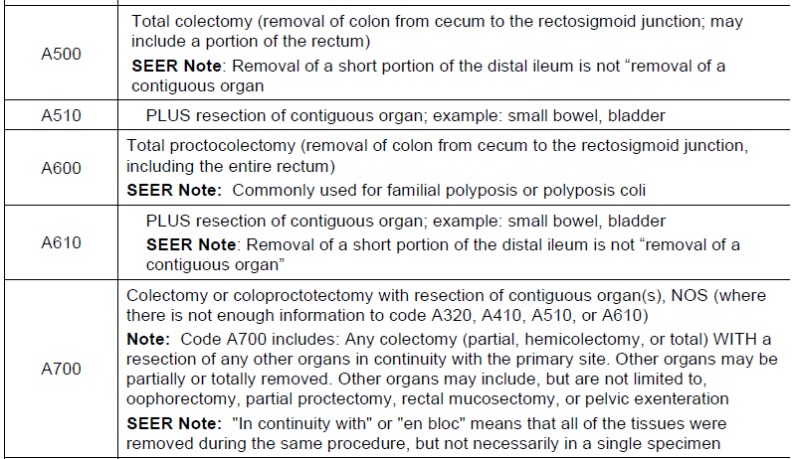
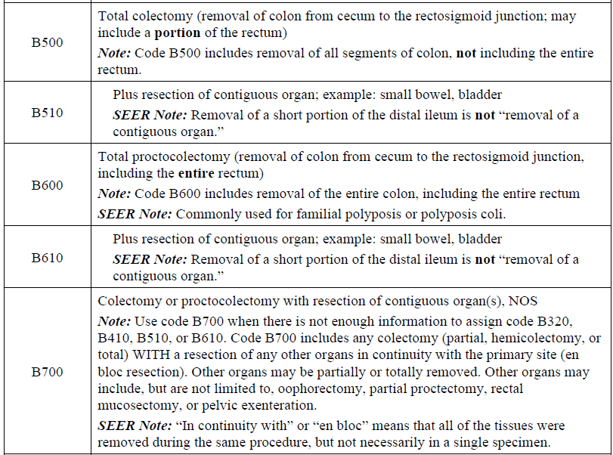
Comparison 2023 vs 2024 Colon Surgery Codes B500-B700 Range
2023
2024
Notes:
These codes are not materially different for 2023 vs 2024 with the exception that they now begin with B instead of A and there is more clarification added to some of the code descriptions.

Slide 45
Pancreas Surgery Code Changes
Minimal Changes
Most of the 2023 “A” codes were converted to 2024 “B” codes without any change in code description.
Notes:
There were minimal changes to the Pancreas surgery codes for 2024.

Slide 46
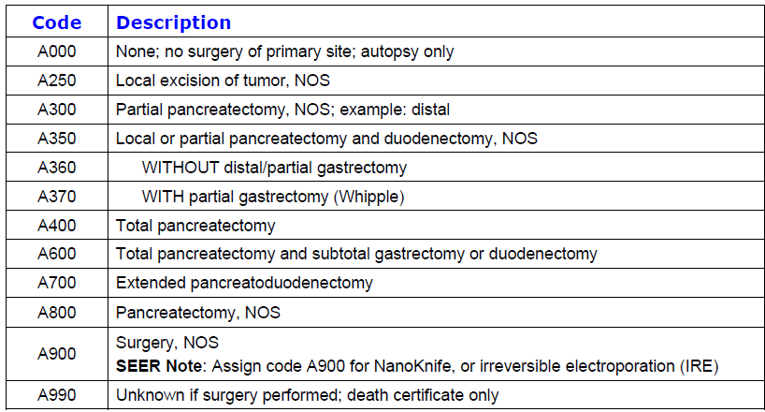
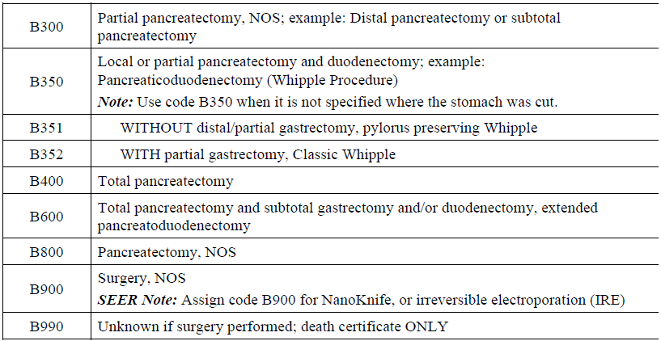
Comparison 2023 vs 2024 Pancreas Surgery Codes
2023
2024
Notes:
If you compare the two boxes in red for 2023 and 2024 codes, you will notice 3 changes:
the new B codes have more information in the description
The number is different for the with and without partial gastrectomy codes: B351, B352 instead of A360, A370. This was for consistency since these are more detailed codes under the broader B350 code.
B351 specifies that pylorus preserving Whipple is included under this code and that B352 includes Classic Whipple.
The last difference is that the specific code for Extended Pancreatoduodenectomy has been retired. For 2024 this is now coded under B600. See the two boxes in blue.

Slide 47
Lung Surgery Code Changes
Most of the 2023 “A” codes were converted to 2024 “B” codes with some clarifications added to code descriptions.
One new code
One retired code
Notes:
There are also only a few changes to the Lung Surgery codes.

Slide 48
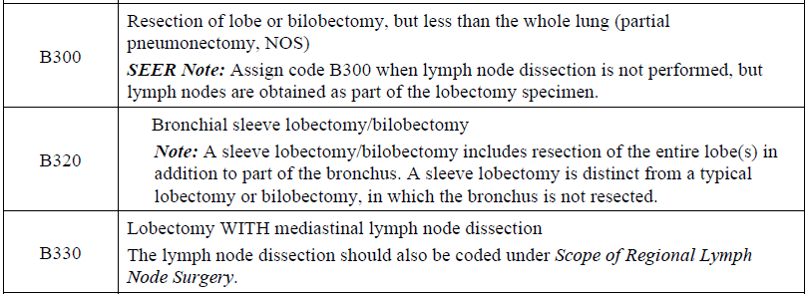
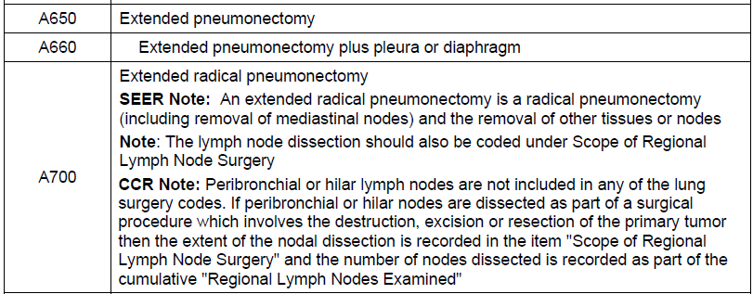
Comparison 2023 vs 2024 Lung Surgery Codes
2023
2024
New
Notes:
The red box show the new code B320, bronchial sleeve lobectomy/bilobectomy. There was not an equivalent code in 2023.
Also, the specific code for Extended radical pneumonectomy has been retired. For 2024 this is now coded under B660. See the two boxes in blue.

Slide 49
Thyroid Surgery Code Changes
No changes
All of the 2023 “A” codes were converted to 2024 “B” codes without any change in code description.

Slide 50
Breast Surgery Code Changes
Reconstruction is no longer incorporated into the surgery codes
There is a new data item Breast Reconstruction Surgery that will capture this information.
The codes and definitions have been completely revised
There is very little correlation between the 2023 “A” codes and 2024 “B” codes.
“That code does not mean what you think it means!”
Notes:
Breast surgery codes had a significant overhaul for 2024. You really need to look at the new table for 2024 to assign the correct codes.

Slide 51
Breast Surgery Code Changes
Codes in B200-B290 range (“partial mastectomy”)
Definitions based on if there was a prior diagnosis of cancer
Carefully read the descriptions of each code
Notes:
The new definitions are based on if there was a prior diagnosis of cancer. Whereas prior to 2024 the codes were just different flavors of partial mastectomy.

Slide 52
Breast surgery Codes
Code | Description
B200 | Partial mastectomy; less than total mastectomy; lumpectomy, segmental mastectomy, quadrantectomy, tylectomy, with or without nipple resection Note: Use code B200 when there is a previous positive biopsy (either core or FNA).
B210 | Excisional breast biopsy - Diagnostic excision, no pre-operative biopsy proven diagnosis of cancer Note: Use code B210 when a surgeon removes the (positive) mass and there was no biopsy (either core or FNA) done prior to the mass being removed. An excisional biopsy can occur when the nodule was previously not expected to be cancer.
B215 | Excisional breast biopsy, for atypia Note: Use code B215 when patient has biopsy that shows atypical ductal hyperplasia (ADH), an excision is then performed, and pathology shows in situ or invasive cancer. The excisional breast biopsy for ADH diagnosed the cancer, not the core biopsy. An excisional breast biopsy removes the entire tumor and/or leaves only microscopic margins. This surgical code was added for situations when atypia tissue is excised and found to be reportable. Approx. 10-15% of excised atypia are cancer and reportable.
B240 | Re-excision of margins from primary tumor site for gross or microscopic residual disease when less than total mastectomy performed
B290 | Central lumpectomy, only performed for a prior diagnosis of cancer, which includes removal of the nipple areolar complex Note: Use code B290 when the nipple areolar complex needs to be removed for patients with Paget disease or cancer directly involving the nipple areolar complex. A central lumpectomy removes the nipple areolar complex, whereas a lumpectomy does not. Central lumpectomy and central portion lumpectomy, central portion excision, central partial mastectomy are interchangeable terms.
Notes:
The first thing I want to point out is the note for B200 which states you assign this code when there is a previous positive biopsy.
Codes B210 and B215 are codes assigned when there is not a diagnosis of cancer prior to the excisional bx. B215 is specifically for patients that have an excisional biopsy for a diagnosis of atypia but then the path shows cancer.
Also note code B290 is only assigned when there is a central lumpectomy done for a prior diagnosis of cancer.

Slide 53
Breast Surgery Code Changes
Mastectomies
Definitions based on what was removed
No codes for reconstruction
Different codes for with and without removal of contralateral breast

Slide 54
Breast Surgery Codes
Code | Description
B300 | Skin-sparing mastectomy Note: A skin-sparing mastectomy removes all breast tissue and the nipple areolar complex and preserves native breast skin. It is performed with and without sentinel node biopsy or axillary lymph node dissection (ALND). SEER Note: Code Goldilocks mastectomy in Surgery of Primary Site 2023 (NAACCR #1291). Breast surgery codes B300, B310, and B320 are the best available choices for "Goldilocks" mastectomy. It is essentially a skin-sparing mastectomy with breast reconstruction. The choice between codes in the B300-B320 range and codes in the B400-B420 range depends on the extent of the breast removal and the contralateral breast removal. Review the operative report carefully and assign the code that best reflects the extent of the breast removal.
B310 | WITHOUT removal of uninvolved contralateral breast.
B320 | WITH removal of uninvolved contralateral breast.
Code | Description
B400 | Nipple-sparing mastectomy Note: A nipple-sparing mastectomy removes all breast tissue but preserves the nipple areolar complex and breast skin. It is performed with and without sentinel node biopsy or ALND.
B410 | WITHOUT removal of uninvolved contralateral breast.
B420 | WITH removal of uninvolved contralateral breast.
Notes:
The B300 and B400 codes are a perfect example of how the codes really do not mean what they used.
You can see that B400 is for nipple-sparing mastectomies. In 2023 those were assigned code A300. And now B300 is for skin sparing mastectomies, which did not have their own code in 2023. You can see how relying on memory of the old surgery codes could really get you into trouble!
You cannot just swap out an “A” for a “B” and assume you have the right code.

Slide 55
Breast Surgery Codes
Code | Description
B500 | Areolar-sparing mastectomy Note: An areolar-sparing mastectomy removes all breast tissue and the nipple but preserves the areola and breast skin. It is performed with and without sentinel node biopsy or ALND. SEER Note: Code the most invasive, extensive, or definitive surgery in Surgery of Primary Site 2023 (NAACCR #1291). Assign code B500, B510 or B520 if a patient has an excisional biopsy followed by an areolar-sparing mastectomy during the first course of therapy. Code the cumulative result of the surgeries, which is an areolar-sparing mastectomy in this case.
B510 | WITHOUT removal of uninvolved contralateral breast.
B520 | WITH removal of uninvolved contralateral breast.
Code | Description
B600 | Total (simple) mastectomy Note: A total (simple) mastectomy removes all breast tissue, the nipple, areolar complex, and breast skin. It is performed with and without sentinel node biopsy or ALND. Use code B600, B610, B620 if patient had a modified radical mastectomy.
B610 | WITHOUT removal of uninvolved contralateral breast.
B620 | WITH removal of uninvolved contralateral breast.
Notes:
In 2023 and earlier areolar sparing mastectomies did not fit into any of the code definitions and per instructions were coded A800. In 2024 there are now specific codes for them, (B500-B520), which is nice.
Also note that the B600 codes for Total Mastectomy include modified radical mastectomy. There is not a separate code for MRM for cases diagnosed 2024 forward.

Slide 56
Breast Surgery Codes
Code | Description
B700 | Radical mastectomy, NOS Note: A radical mastectomy removes all breast tissue, the nipple areolar complex, breast skin, and pectoralis muscle. It is performed with level l-III ALND
B710 | WITHOUT removal of uninvolved contralateral breast.
B720 | WITH removal of uninvolved contralateral breast.
Code | Description
B760 | Bilateral mastectomy for a single tumor involving both breasts, as for bilateral inflammatory carcinoma SEER Note: Assign code B760 for a more extensive bilateral mastectomy for a single primary involving both breasts. Assign code 0 in Surgical Procedure of Other Site (NAACCR #1294).
B800 | Mastectomy, NOS (including extended radical mastectomy)
Notes:
Extended radical mastectomy no longer has its own code. It is now coded under B800.

Slide 57
Breast Reconstruction – New Data Item
NAACCR Item #1335
Required by CCR for cases diagnosed 2024+
Describes the reconstruction procedure immediately following resection of the breast.
This information was previously collected within the Breast surgery codes.
Collection of this new data item supports the Synoptic Operative Report and allows for more descriptive reconstruction codes.
Notes:
As I mentioned earlier and as you saw going the breast surgery codes, reconstruction is no longer incorporated into the surgery codes and there is a new data item Breast Reconstruction that will capture this information.
This data item is required by CCR for cases diagnosed 2024 and forward.
It describes the reconstruction procedure immediately following the resection of the breast.

Slide 58
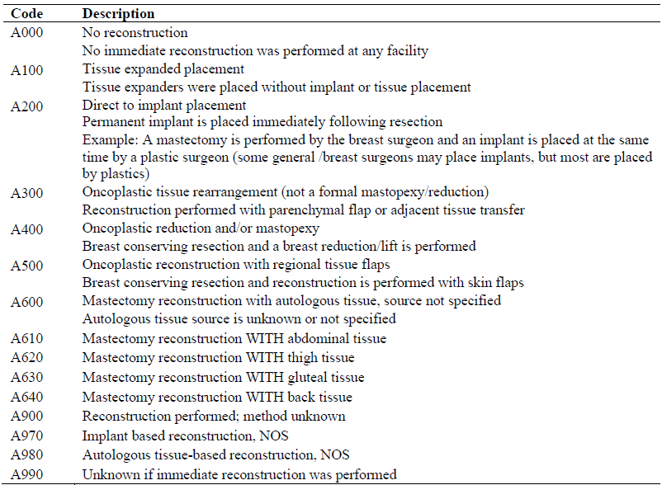
Breast Reconstruction
Notes:
You can see that this data items allows for coding reconstruction in more granular detail than was previously captured in the Breast surgery codes.

Slide 59
Breast Reconstruction – New Data Item
Immediate reconstruction is defined as reconstruction performed during the same operative session as the procedure coded in Surgery of Primary Site 2023.
DO NOT record reconstruction performed on a different day (assign code A000)
Code only the ipsilateral breast reconstruction.
Assign code A000 if the reconstruction was started but not completed.

Slide 60
Thank You!
Janine Smith
jdssmith@ucdavis.edu

