Slide 1
Why are state cancer registries critically important
in the fight against cancer?
Cancer Registry Impacts
Notes:
Why do we need cancer registries in every state?

Slide 2
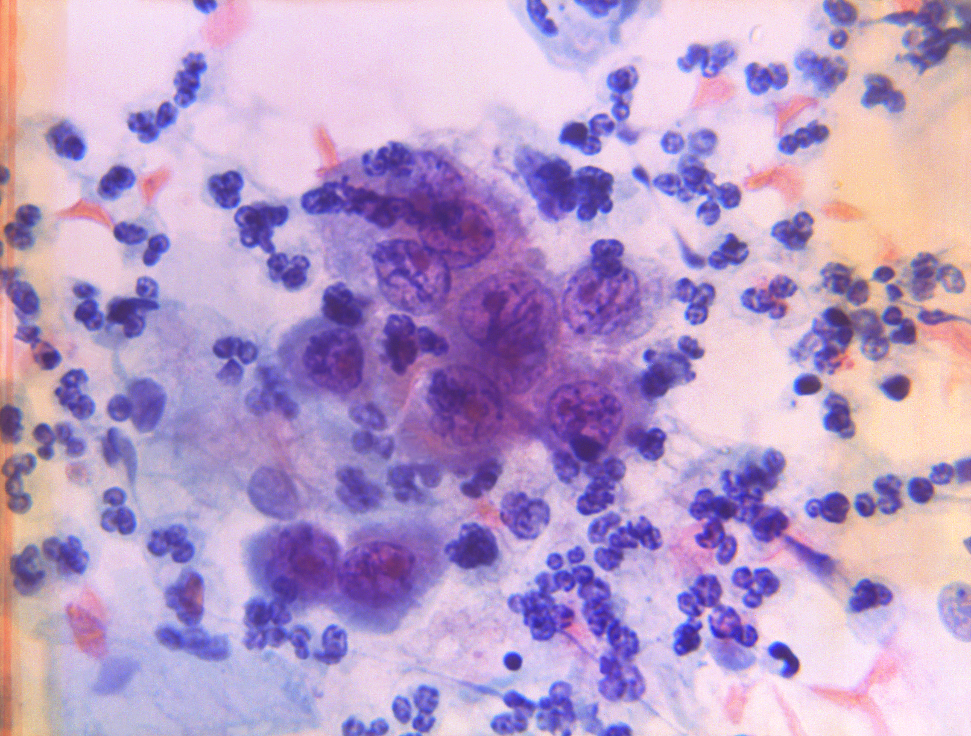
1. Cancer registries tell you how important cancer is
1 in 3 Americans will get cancer
Every day, 5,600 Americans are newly diagnosed with cancer
Every minute, 1 American dies from cancer
https://www.cancer.org/research/cancer-facts-statistics/all-cancer-facts-figures/2025-cancer-facts-figures.html
Notes:
What do we - the registry community - make possible?
First, we tell you how important cancer is. 1 in 3 of us will get cancer in our lifetimes. 5600 Americans are diagnosed with cancer every day. Every minute, someone in this country dies from cancer.

Slide 3

2. Cancer registries are a cornerstone of cancer research
PubMed research publications including “cancer registry/ registries”, “SEER”, or “cancer surveillance” 42,756 research papers
Even more studies & clinical guidelines cite cancer registry data, covering:
  Trends in incidence and mortality
  Cancer in children, adolescents, young adults
  Early onset cancer (<50)
  How to prevent cancer
  How best to screen for cancer
  What are the causes of cancer?
  Who is at greater risk of cancer?
  Investigating “cancer clusters”
  Is treatment effective?
  Is treatment cost effective?
  Developing new treatments
  Developing standard treatment guidelines
  How long do people live after diagnosis?
  Factors predicting good or bad outcomes
  Who is at risk of a second cancer?
  Whose family is at greater risk of cancer?
Notes:
Cancer registries are a foundation for cancer research. If you search Pubmed titles and abstracts for these key phrases, you get more than 42k papers primarily focused on registry data, with countless other papers that use and cite our data. It's hard to describe just how huge these impacts are.

Slide 4
2. Cancer registries are a cornerstone of cancer research
The most cited publications on aging & cancer are registry-based
(Top 10 from Web of Science through 2022)
Rank | Article title | Times cited | Published | Citations per year
1 | Cancer statistics, 2010 | 39,141 | 2010 | 3262
2 | Cancer statistics, 2014 | 20,730 | 2014 | 2591
3 | Cancer statistics, 2016 | 16,789 | 2016 | 2798
4 | Cancer statistics in China, 2015 | 12,298 | 2016 | 2050
5 | Cancer statistics, 2008 | 9642 | 2008 | 689
6 | Cancer statistics, 2009 | 9047 | 2009 | 696
7 | Cancer statistics, 2018 | 6774 | 2018 | 1693
8 | Cancer statistics, 2007 | 6614 | 2007 | 441
9 | Effects of chemotherapy and hormonal therapy for early breast cancer on recurrence and 15-year survival: an overview of the randomized trials | 5599 | 2005 | 329
10 | Cancer statistics, 2020 | 5533 | 2020 | 2766.5
Zhang et al, Medicine 102(32):p e34428, August 11, 2023.
Notes:
This study identified the most cited papers on aging and cancer in the scientific literature, from the inception of the web of science website (1980), 9 of the top 10 most cited papers are registry data – and 8 of those are from the US

Slide 5
3. Cancer registries provide data for many important studies
EXAMPLES
Breast Cancer Surveillance Consortium
California Teachers Study
Cohort Study of Lead-Exposed Workers
Colon Cancer Family Registry
Cancer Prevention Study-3
Childhood Cancer Survivor Study
Iowa Women’s Health Study
National Childhood Data Initiative
National Firefighter Registry for Cancer
New England Bladder Cancer Study
NIH-AARP Study
Skin Cancer Prevention Study
Southern Community Cohort Study
Transplant Cancer Match Study
U.S. Radiologic Technologist Study
Women’s Health Initiative
https://coloncfr.org/publications/ https://cancercontrol.cancer.gov/research-emphasis/supplement/childhood-cancer-registry
https://www.cdc.gov/niosh/firefighters/registry/index.html Colt, Occup Environ Med,. 2011 Apr;68(4):239-49. Jacobs 2017 A J Epidemiol 186; 7; 876-884
Notes:
We provide data for many important research studies. For example, the Breast cancer surveillance consortium has published more than 800 papers describing new knowledge about breast cancer screening, and cancer risk factors such as breast density.

Slide 6






3. Cancer registries provide data for many important studies
National Childhood Cancer Data Initiative
Aims to pool data for every US child, adolescent & young adult with cancer, using cancer registry data to create the largest, strongest possible dataset for research
This initiative needs data from every state. Funding for all state cancer registries is critical
America’s children with cancer
https://www.cancer.gov/research/areas/childhood/childhood-cancer-data-initiative/stories/patients https://dragonmaster.org/about-us/
Notes:
The National Childhood Cancer Data Initiative aims to use registry data from every state to create the strongest possible dataset for research on this critically important topic. If registries shut down, this is one of many initiatives that will be affected. Amanda Haddock, mother of David who died of brain cancer, is trying to get David's brain cancer data used for research. (See https://dragonmaster.org/about-us/). Childhood cancer research needs to be strengthened, not weakened.

Slide 7
4. Cancer registries provide data for many important public health interventions
EXAMPLES
Breast & Cervical Cancer Early Detection Program
Congressionally mandated CDC-funded screening for low-income women
Comprehensive Cancer Collaboration
Cancer coalitions in all states to reduce the burden of cancer
NCI Cancer Center Support Grants (P30)
57 NCI-designated Comprehensive Cancer Centers, whose work includes outreach to reduce cancer burden in catchment areas
World Trade Center Health Program
Covers health care for 137,000 responders and survivors
White et al, Cancer. 2017 Dec 15;123(Suppl 24):4969–4976. https://www.cancer.gov/research/infrastructure/cancer-centers
Notes:
We provide data for many important public health interventions.

Slide 8
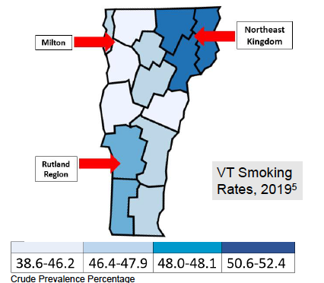
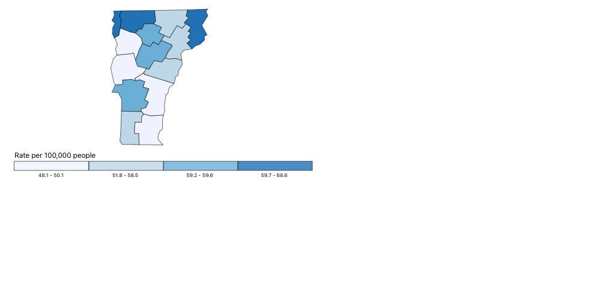
4. Cancer registries provide data for many
important public health interventions
VT lung cancer age-adjusted incidence 2017-21
Lung cancer screening interventions in Vermont targeted resources to areas of greatest need, based on smoking prevalence & lung cancer incidence
United States Cancer Statistics: Data Visualizations, CDC, https://gis.cdc.gov/cancer/USCS/#/StateCountyTerritory/
Notes:
A team at the Dartmouth Cancer Center targeted lung screening educational interventions to counties in Vermont with high smoking prevalence and high lung cancer rates. When resources are scarce, we can use registry data to focus interventions on communities of greatest need.

Slide 9
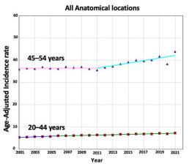
Early-onset colorectal cancer is increasing:
- in ages 45-54 by 0.7% per year
- in ages 20-44 by 1.5% per year
And the Colon Cancer Family Registry, using cancer registry data has taught us a lot about inherited cancer syndromes & early-onset cancer (>700 published research papers)
5. Cancer registries identify concerning trends over time
Abboud et al. Cancers. 2025;17(9):1500 https://coloncfr.org/
Notes:
We identify concerning trends over time. Registry data identified the rise of Colorectal Cancer in younger adults. And the Colon Cancer Family Registry has used our data and published over 700 papers with new information about inherited cancer syndromes and early onset cancer.

Slide 10
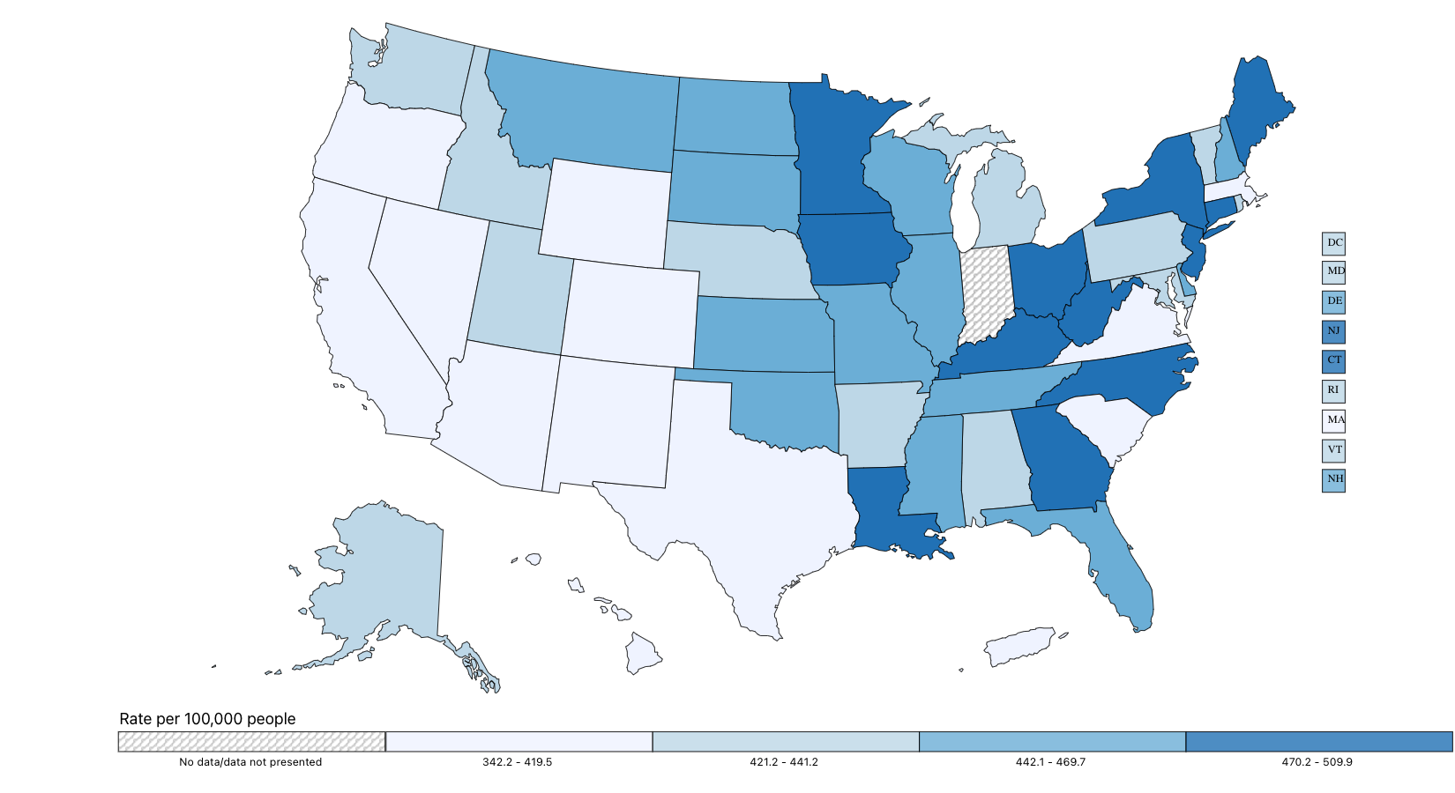
6. Cancer registries identify concerning patterns
Kentucky’s cancer rate is 39% higher than New Mexico’s
https://gis.cdc.gov/cancer/USCS/#/AtAGlance/
Notes:
We identify concerning patterns. We can tell you that even taking age into account, for every hundred cancer patients in new Mexico, Kentucky has 139

Slide 11
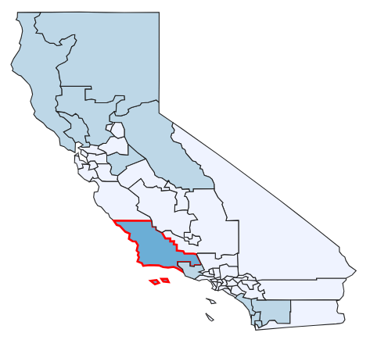
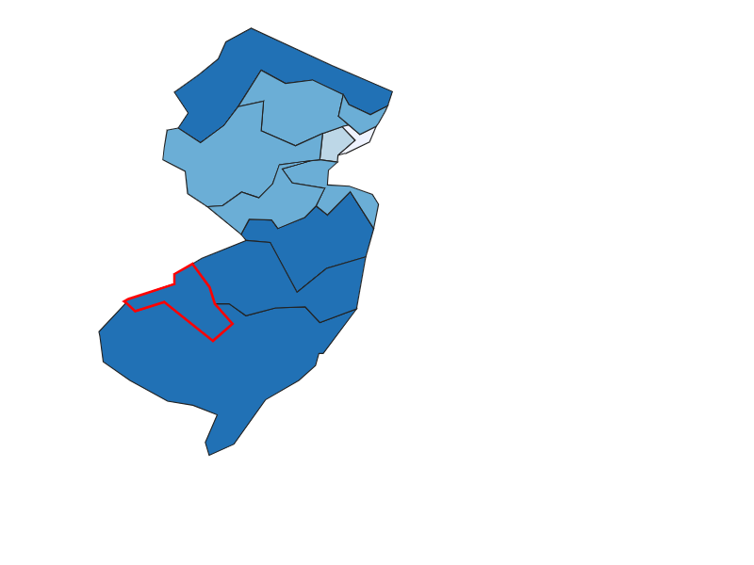
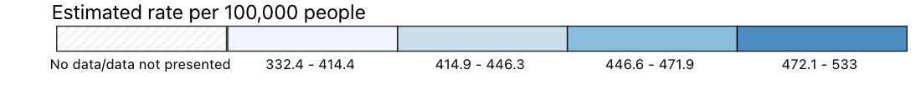
7. Cancer registries inform legislators about cancer in their districts
California Congressional District 24 has the highest rate of cancer in CA - 22% higher than District 28
New Jersey Congressional District 1 has the highest rate of cancer in NJ –14% higher than District 12
https://gis.cdc.gov/cancer/USCS/#/CongressionalDistricts/
Notes:
The CDC publishes maps of cancer by congressional district informing legislators about cancer issues in the people they serve. They probably don't want to lose this resource, but perhaps they don’t realise it’s threatened.

Slide 12
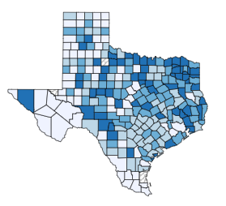
8. Cancer registries inform legislators about concerning trends
Texas Cancer Registry reported to legislators on cancers before age 50, with increases in:
Early-onset uterine cancer (APC 3.5%)
Early-onset colorectal cancer (APC 2.3%)
Early-onset kidney cancer, breast cancer
APC = Annual Percent Change
https://narrative.naaccr.org/tcr-investigates-early-onset-cancer-trends/ https://gis.cdc.gov/cancer/USCS/#/StateCountyTerritory/
Notes:
Texas Cancer Registry reported to their politicians on the increasing rate of cancers before age 50, with significant increases in several cancer types.

Slide 13

9. Cancer registries inform public policy
President Trump cited cancer statistics in Feb 2025 Executive Order:
“Across 204 countries and territories, the United States had the highest age-standardized incidence rate of cancer in 2021, nearly double the next-highest rate. Further, from 1990-2021, the United States experienced an 88 percent increase in cancer, the largest percentage increase of any country evaluated.”
https://www.whitehouse.gov/presidential-actions/2025/02/establishing-the-presidents-make-america-healthy-again-commission/
Wu et al. J Hematol Oncol. 2024 Nov 29;17:119.
Notes:
We inform public policy. Cancer statistics were used in this Executive Order. Unfortunately, it used a secondary data source based on registry data and there’s some inaccuracy in the interpretation but this illustrates the importance of cancer data in public policy

Slide 14
10. Cancer registries provide data to investigate community cancer concerns
EG Camp LeJeune Study, North Carolina
1953-85 - US Marine Corps Base Camp Lejeune’s drinking water highly contaminated eg TCE, benzene, vinyl chloride
54 US Cancer Registries identified cancers for the study
hematological cancers, lymphoma, & cancers of esophagus, larynx, thyroid, lung
~ 1 million people exposed over 32 years
Disability & healthcare benefits provided to Veterans & families
Photo by Lance Cpl. Kyle Baskin https://media.defense.gov/2025/Feb/25/2003651598/-1/-1/0/250210-M-QX760-1375.JPG, Bove et al Environ Health 2024;23:61
Bove et al. Envir Health Perspect 2024, 132, 10: 107008 https://www.va.gov/disability/eligibility/hazardous-materials-exposure/camp-lejeune-water-contamination/
Notes:
We provide data to explore community concerns about cancer. At Camp Lejeune more than a million people were exposed to polluted drinking water over decades. With data from 54 registries, veterans and their families were found to be at greater risk of several cancers and they were promised disability and healthcare benefits as a result.

Slide 15
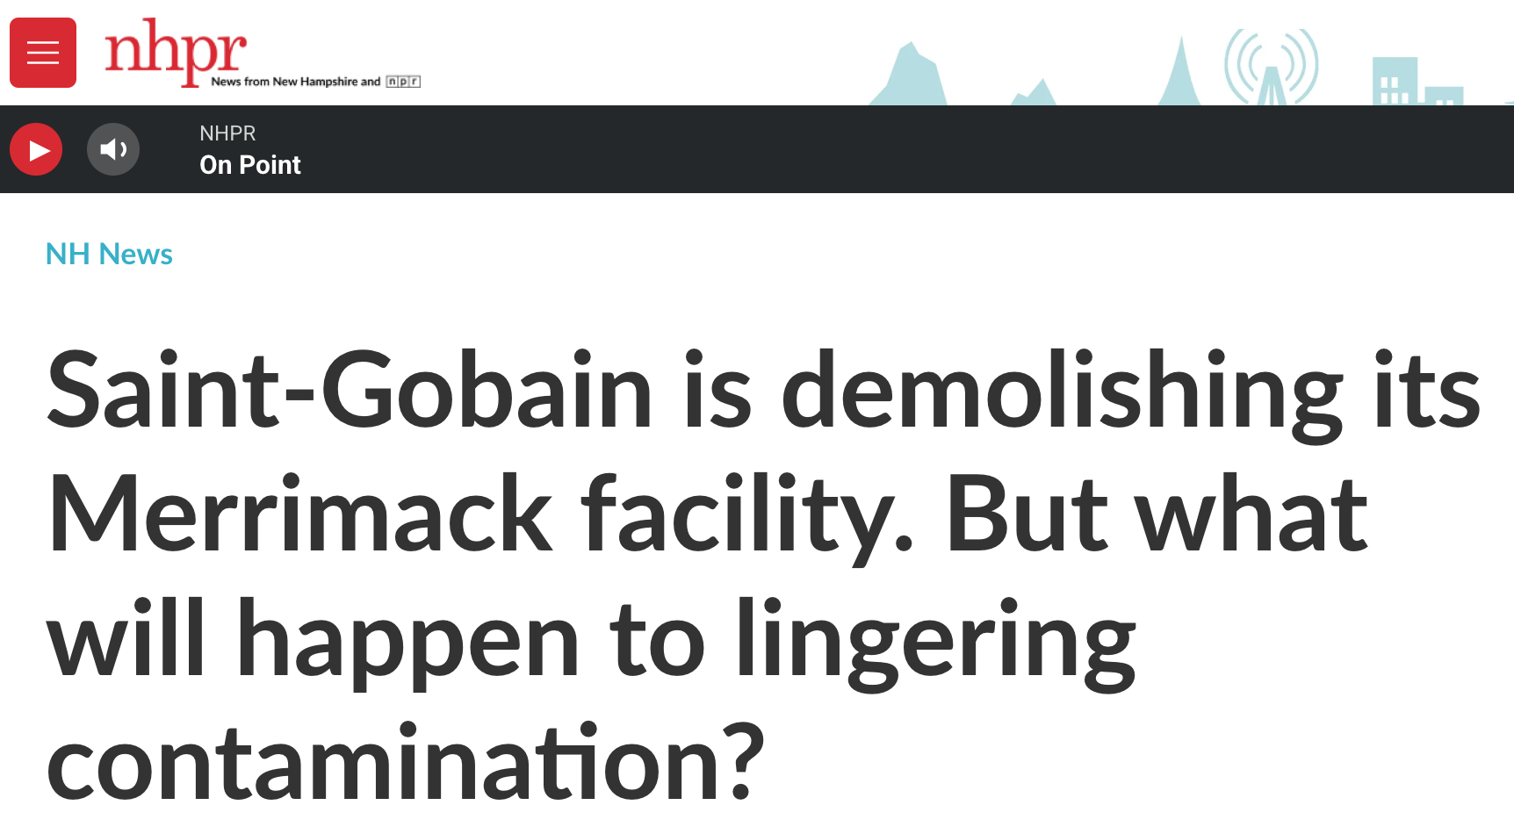

10. Cancer registries provide data to investigate community cancer concerns
EG Merrimack, NH Kidney Cancer Study
PFAS manufactured in Merrimack Town, NH, entered public drinking water via air from the factory
2023 Merrimack Town kidney cancer SIR 1.42 (95% CI 1.10-1.81)
Led to State funding of pilot study to investigate it and the factory is being demolished
State Rep Wendy Thomas has dealt with “cancer that she attributes to 12 PFAS chemicals detected in her blood above the toxic limit for humans”
Article by Mara Hoplamazian, https://www.nhpr.org/nh-news/2024-12-13/saint-gobain-is-demolishing-its-facility -in-merrimack-but-what-will-happen-to-lingering-contamination https://www.dhhs.nh.gov/sites/g/files/ehbemt476/files/inline-documents/sonh/cancer-incident-report-merrimack-nh-january2023.pd
https://newhampshirebulletin.com/2025/01/30/those-harmed-by-forever-chemicals-have-six-years-to-sue-in-nh-lawmakers-want-more-time/
Notes:
In NH, registry data is being used, with state funding of a pilot study of kidney cancer near a factory releasing airborne PFAS which contaminated the public water supply. The factory is now going to be demolished, although these forever chemical carcinogens take many many years to break down in the environment and in people’s bodies.

Slide 16
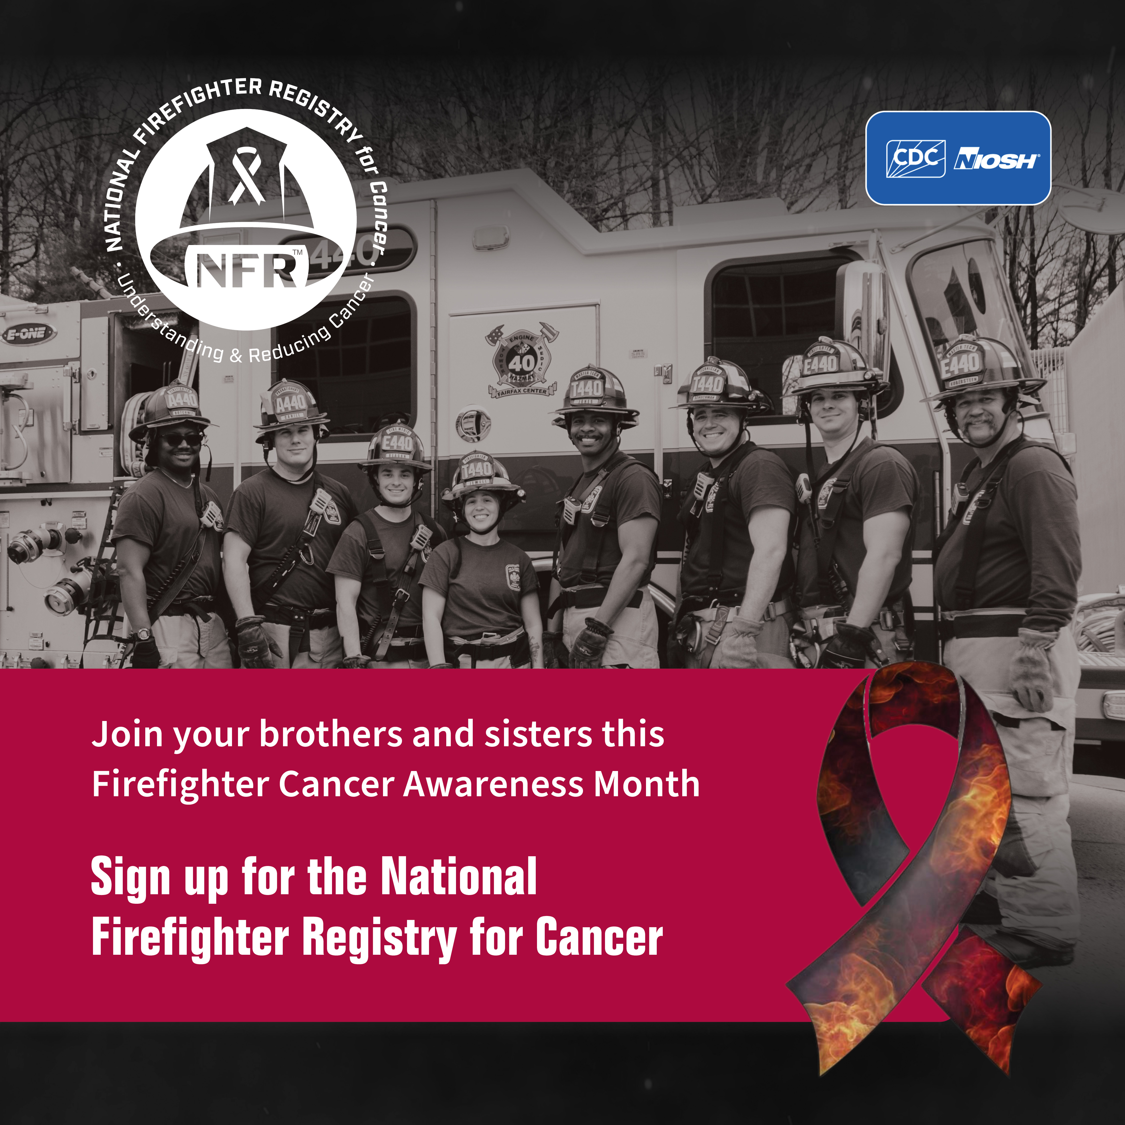
11. Cancer registries identify people at greater risk from cancer
Firefighters are at greater risk of cancers
  Pleura (60% higher risk), testis (34%), thyroid (22%), melanoma (21%), prostate (15%), colon (14%), bladder (12%), rectum (9%)
Firefighter Cancer Registry Act of 2018
  Began the National Firefighter Registry for Cancer, run by NIOSH
This initiative needs data from every state.
Funding for all state cancer registries is critical
https://www.cdc.gov/niosh/firefighters/registry/cancer-awareness-month-toolkit.html Jalilian, Int J Cancer 2019; 145; 10; 2639-2646 https://nihrecord.nih.gov/2023/08/18/fire-department-celebrates-70th-anniversary Photo Mat Chibbaro
https://www.cdc.gov/niosh/firefighters/registry/index.html https://gc.nh.gov/bill_status/legacy/bs2016/billText.aspx?id=856&txtFormat=html&sy=2023
Notes:
We help identify people at greater risk from cancer. like Firefighters
Now there is a cancer registry for firefighters but they need state registries to provide data for it.

Slide 17

11. Cancer registries identify people at greater risk from cancer
FANS Study (PI Scarlett Gomez)
Investigates the unexpectedly high rates of lung cancer in
Female Asian Never Smokers
Usually, 15% of people diagnosed with lung cancer are ‘never smokers’
But 57% of Asian American women diagnosed with lung cancer have never smoked
DeRouen, JNCI, Volume 114, Issue 1, 2022, P78–86
https://fansstudy.ucsf.edu/home
Notes:
Scarlett Gomez is investigating why so many Asian American women with lung cancer have never smoked. 57%, compared to 15% in other races. Registries support that work.

Slide 18
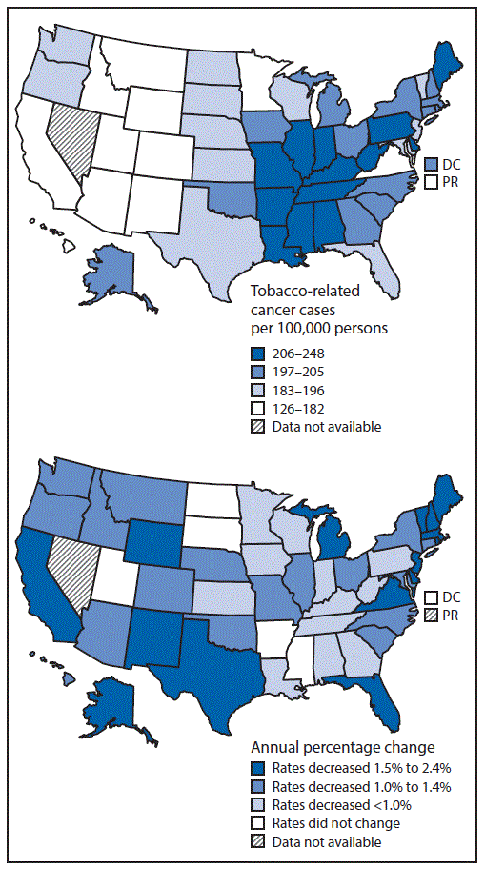
Tobacco causes at least 12 types of cancer
These cancer rates are very different on the east and west sides of the country
Tobacco-related cancer incidence has decreased significantly in 44 states
12. Cancer registries show if investments in public health are working
Age-adjusted rate of tobacco-related cancers (2009–2013) and trends in rates (2004–2013), by state — NPCR and SEER, United States
https://www.cdc.gov/mmwr/volumes/65/wr/mm6544a3.htm
Notes:
We show if public health interventions are working. Here we can see fewer smoking-related cancers in the west half of the country. The second map shows how quickly this is changing.

Slide 19
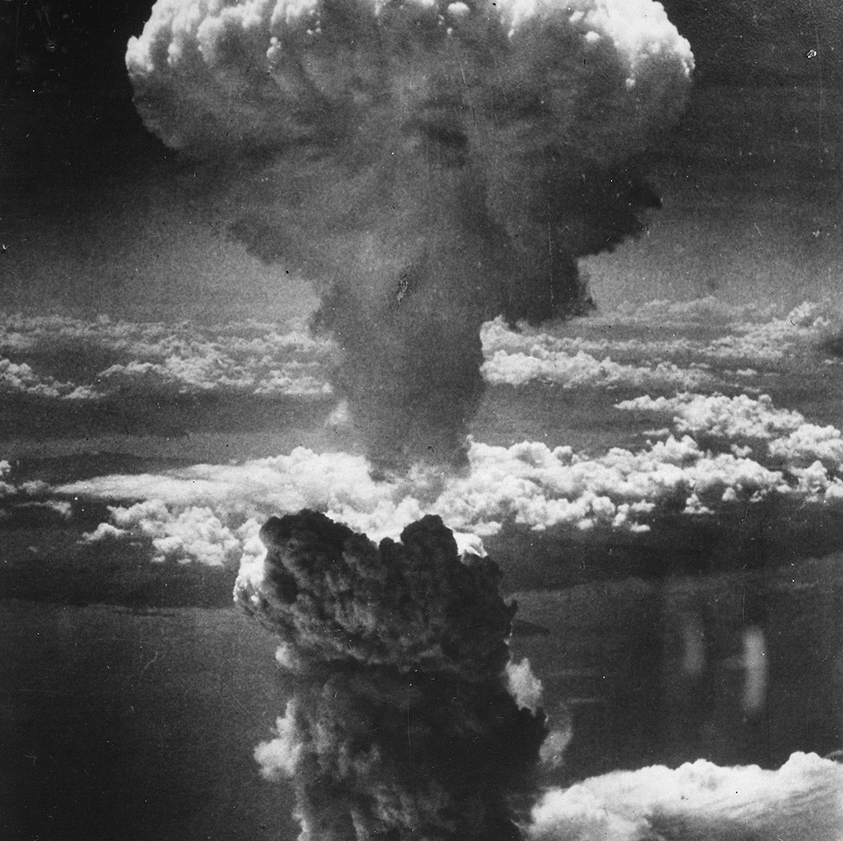
13. Cancer registries help identify causes of cancer
Our understanding of cancer risk due to ionizing radiation was based on cancer registries in Hiroshima and Nagasaki, Japan ….
Thompson, Radiat Res 1994, 137 (2s): S17–S67.
The atomic cloud rising over Nagasaki, Japan. National Archives ID 535795 - https://www.archives.gov/news/topics/hiroshima-nagasaki-75
Notes:
Cancer registry data helps identify causes of cancer. Japanese cancer registries helped understand the impact of ionizing radiation from atomic bombs on cancer risk….

Slide 20

13. Cancer registries help identify causes of cancer
… 80 years on, minimizing radiation exposure from CT scans is being prioritized.
~ 4870 cancers may result from the 4 million CT scans done every year on US children.
Miglioretti, et al. JAMA Pediatr. 2013, 167, 700–707.
Budoff et al Circulation. 2006;114(16):1761-179117015792
Notes:
… and 80 years on, we are still learning of the need to reduce our exposures to ionizing radiation. One study has estimated that the 4 million CT scans that were being done each year in American children would lead to more than 4000 cancers over their lifetimes.

Slide 21
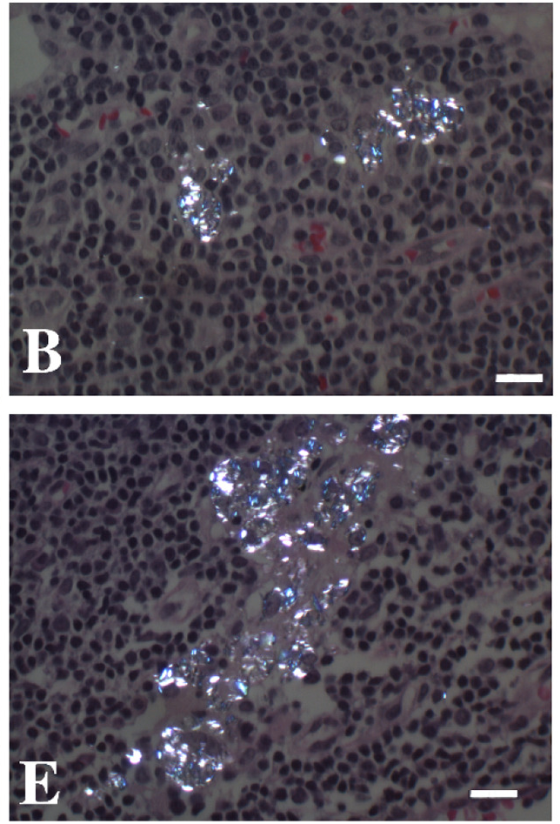
13. Cancer registries help identify causes of cancer
Ovarian cancer studies -
1992 - talcum powder linked to ovarian cancer
Talc contaminated with asbestos is classified as a carcinogen (IARC Group 1)
Talc alone is classified as a probable carcinogen (IARC Group 2A)
2023 - Johnson & Johnson discontinued talc-based baby powder
Talc in ovarian cancer
lymph nodes
Harlow et al 1992 Obstetrics and Gynecology 1992-07; 80 (1), 19-26 https://monographs.iarc.who.int/list-of-classifications
Johnson et al Gynecologic Oncology 2020, 159(2); 527-533 Cramer et al, Epidemiology. 2016 Apr 1;27(3):334–346
Notes:
Other work includes studies of ovarian cancer, leading to better understanding of the risks associated with genital use of talcum powder; and in 2023 Johnson & Johnson stopped selling talc-based baby powder. In the picture you can see white talcum powder in lymph nodes that has spread from the ovarian cancer.

Slide 22

13. Cancer registries help identify causes of cancer
Bladder cancer studies -
Exposure to arsenic in drinking water is linked to bladder cancer
  - even at low concentrations
2021 NH law reduced arsenic MCL in drinking water from 10 to 5 ppb….
… and led to a large birth cohort study of early life exposures to arsenic & other environmental health risk factors
Baris et al J Natl Cancer Inst. 2016 May 2;108(9):djw09 https://www.cdc.gov/bladder-cancer/about/index.html
https://www.des.nh.gov/news-and-media/blog/more-protective-arsenic-standard-will-reduce-risk-many#
New Hampshire Birth Cohort Study grant: 5UG3OD023275-09 PI Karagas https://deepai.org/machine-learning-model/text2img
Notes:
Bladder cancer research using registry data in New England led to a better understanding of the risks of arsenic contamination of drinking water, even at low concentrations. This work contributed to stronger drinking water standards in NH and more research funding to understand the risks of arsenic exposure in young children.

Slide 23
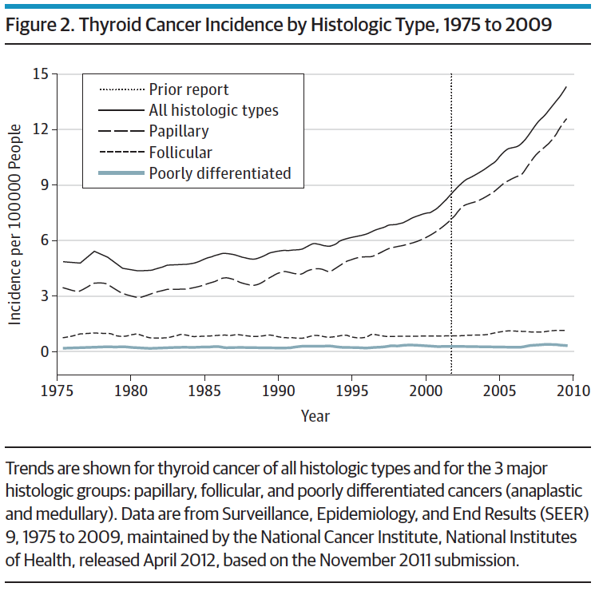
13. Cancer registries help identify causes of cancer
Thyroid cancer studies -
Increasing thyroid cancer in US first reported through Connecticut Cancer Registry after Chernobyl disaster,¹ driven by small papillary thyroid cancer²
Mortality is stable
Radiologic imaging is playing a role in diagnosis or causality³
Cramer. Surgery 2010. 148(6):1147-1153
1. Mangano. Eur J Cancer Prev, 1996, 5(1);75-81 2. Davies & Welch, JAMA 2006, 295:2164-2167 3. Zhang. Eur J Cancer Prev. 2015;24(5):439–446
Notes:
Registry data has shown increases in thyroid cancer over time, and research continues into the role of medical imaging – either causing some cancers through radiation, or identifying more tiny cancers that might not otherwise have come to light (“overdiagnosis”)
.

Slide 24
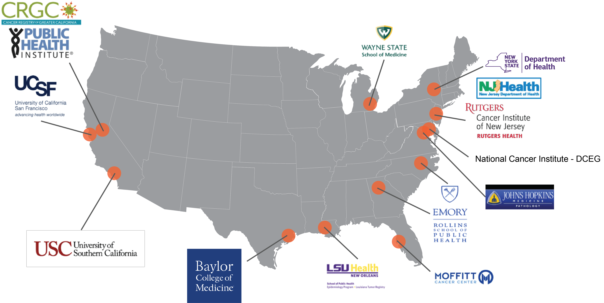
14. Cancer registries help understand how complex cancer is
The RESPOND cohort
The largest study ever of prostate cancer health in 12,500 African American men
Participants identified through cancer registries
U01CA287036 – PI Haiman - Identifying factors associated with prostate cancer progression and survival in African American men: The RESPOND Cohort
Notes:
The RESPOND study is helping us understand the complexity of prostate cancer, which has disproportionate impacts in African American men

Slide 25

15. Cancer registry data is cited in key clinical guidelines
Breast cancer screening 2024
  All women screen every other year from 40 (vs. start between 40-50)
Colorectal cancer screening 2021
  Start to screen from 45 (lowered from 50)
Lung cancer screening 2021
  Annual low-dose CT in adults 50-80y with a 20 pack-year smoking history and currently smoke or have quit within past 15 years.
USPSTF – US Preventive Service Task Force - https://www.uspreventiveservicestaskforce.org/uspstf/recommendation-topics/uspstf-a-and-b-recommendations
Notes:
We are cited in many clinical guidelines of the US Preventive Services Task Force

Slide 26

15. Cancer registry data is cited in key clinical guidelines
Skin cancer: screening 2023
Breast Cancer: Medication Use to Reduce Risk 2019
BRCA-Related Cancer: Risk assessment, genetic counselling & testing 2019
Pancreatic Cancer: Screening 2019
Cervical Cancer: Screening 2018
Prostate Cancer: Screening 2018
Skin Cancer Prevention: Behavioral Counseling 2018
Ovarian Cancer: Screening 2018
Thyroid Cancer: Screening 2017
Oral Cancer: Screening 2013
USPSTF – US Preventive Service Task Force https://www.uspreventiveservicestaskforce.org/uspstf/recommendation-topics/uspstf-a-and-b-recommendations
https://www.cdc.gov/skin-cancer/symptoms/index.html
Notes:
Here are ten more.

Slide 27
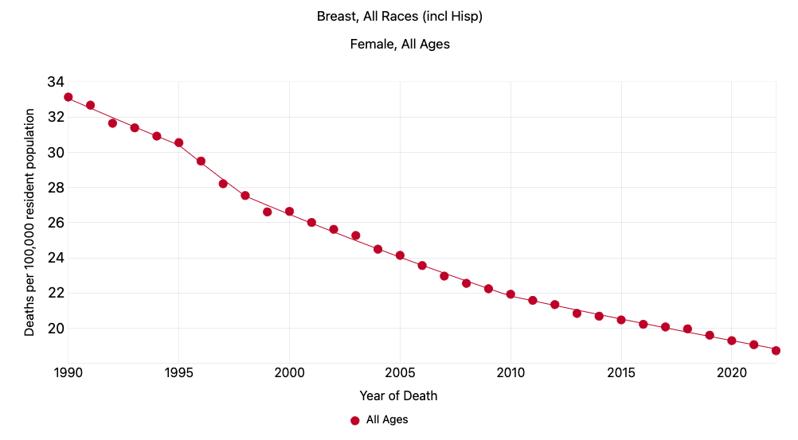
16. Cancer registries show you if we are winning the fight against each type of cancer
EXAMPLE
Breast cancer mortality has fallen by 42% since 1990
Statecancerprofiles.cancer.gov
Notes:
We can show at the population level if cancer treatments are working. For example, over 50 years, the number of patients living 5 or more years with a diagnosis of leukemia has doubled

Slide 28
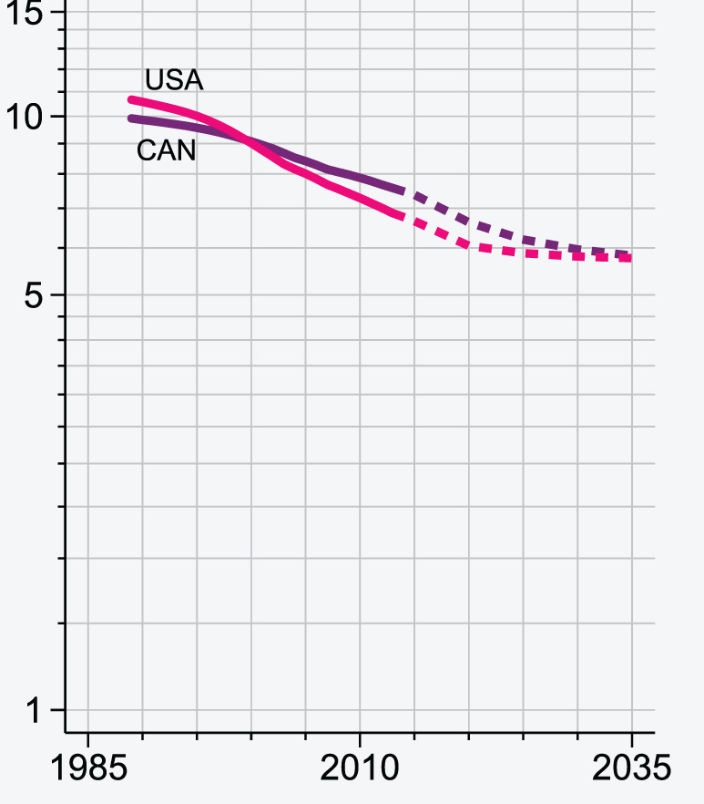
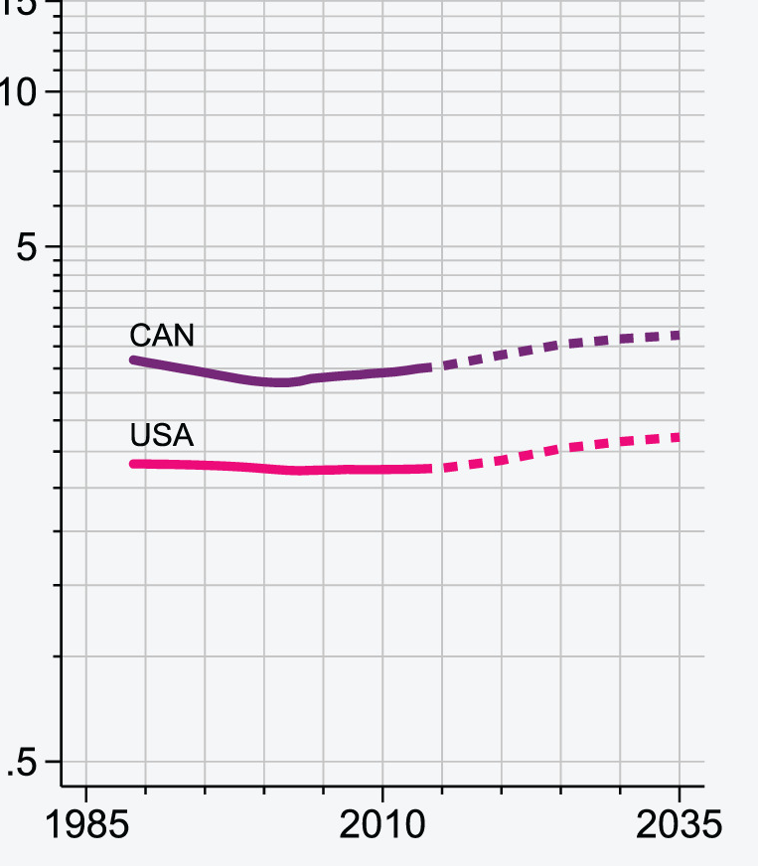
17. Cancer registries help plan for the future
Colon cancer
Despite decline in overall colorectal cancer mortality rate (2013-2035), there are opposite trends for colon and rectal cancer
The number of rectal cancer deaths will double by 2035 in the U.S.
Age-standardized mortality/100,000/year
Rectal cancer
Araghi et al. Int J Cancer. 2019 Jun 15;144(12):2992-3000
Notes:
Understanding trends helps us plan for the future. Colon cancer mortality is decreasing. Rectal cancer mortality is increasing and deaths from rectal cancer will double in the next decade.

Slide 29
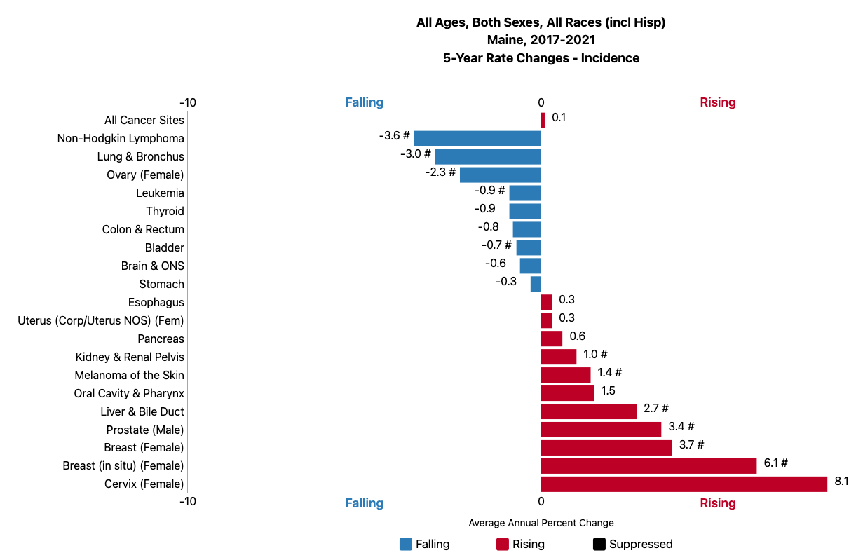
17. Cancer registries help plan for the future
But national and state cancer patterns are not necessarily the same
EXAMPLE
  US liver cancer is decreasing by 1.2% each year
  But in Maine, it’s increasing by 2.7%
Every state must have a cancer registry
Statecancerprofiles.cancer.gov
Notes:
Planning for the future often means planning differently in different states. eg in the US, liver cancer is decreasing by 1% per year. In Maine, a state with very high rates of infectious hepatitis (a cause of liver cancer), liver cancer is increasing by 2.7% annually. This is another example of inter-state differences highlighting the need for a registry in every state

Slide 30
Our data are the basis for much of what we know about cancer and how to fight it.
Without properly funded cancer registration in every state to tell us what’s going on, we are blindfolded in this fight.
https://monographs.iarc.who.int/wp-content/uploads/2019/12/OrganSitePoster.PlusHandbooks.pdf © International Agency for Research on Cancer 2025, Accessed May 15, 2025
Notes:
Our data are the basis for much of what we know about cancer and how to fight it. Without a properly funded cancer registry in every state to tell us what’s going on, the nation is blindfolded in this fight

